Slide 1
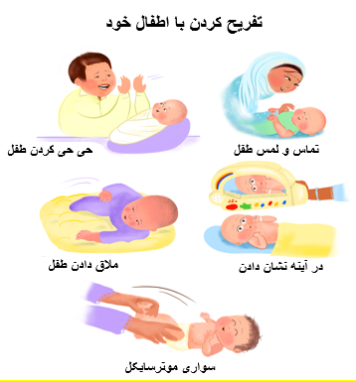
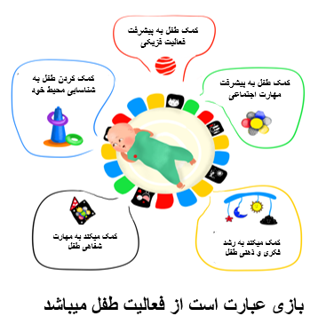
توانمندی بازی
This poster has been created with financial support from the Aga Khan Foundation and Global Affairs Canada, and its content is derived from the Aga Khan University literature

Slide 2
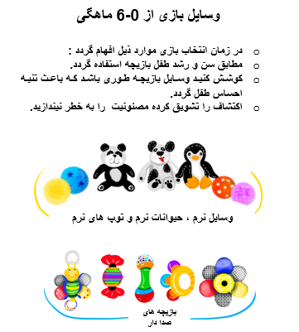
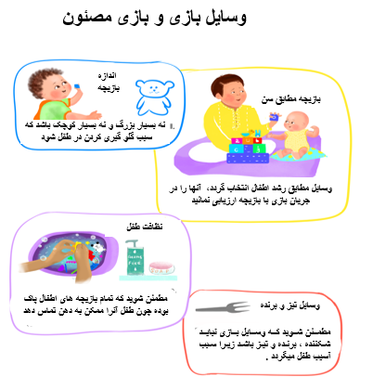
For any questions or information, please contact the Aga Khan Health Services Centre nearest to your area.

