Slide 1



SCHOOLS2030 DESIGN SPRINT
TEAM
WORKBOOK
COUNTRY / DATE

Slide 3

KEY
PHASES OF THE DESIGN PROCESS & WHAT IS INCLUDED IN THE TOOLKIT
Personal Activity
For this process, there are eight phases. Each phase has different
tools and activities that you and your design team will need
to complete in order to move to the next phase.
During your design journey, you will be provided with 2 workbooks:
  A4 Personal Design Workbook – This workbook is for activities that require you to provide your personal experience as an educator, knowledge about your classroom environment and insights about your learners. It will also provide you with tools for self-reflection and capturing your thoughts before sharing them with the rest of your team.
  An A3 Design Team Workbook. – This workbook will provide you with tools that bring your collective thoughts, experiences and ideas together, guide you as a team to achieve joint objectives and a space to summarize and document your collective design decisions.
Welcome to your Design Team Workbook.
Within each workbook are specific tools that you will fill in or use.
See below for a list of the phases and tools included in both the
Personal and Team workbooks.
The Tools Highlighted in Green are the only tools you will use in this workbook. Throughout the workbook, at the beginning of each phase, there is an introduction page with context and goals for the phase and a highlight
of the tools. Your Design Facilitator will provide you with instructions on
how to complete the activities & tools before using them, but incase
you are in doubt, always seek clarification. We are on this journey together.
Group Activity
OUR DESIGN JOURNEY
1
2
3
4
LAUNCH
1. Classroom Data Walk – LO
2. Prioritize Learning Outcome
3. Select Learning Outcome Sub-Domains
4. Classroom Data Walk and Reflection – LE
5. Select Learning Environment Practices
6. LAUNCH Summary
EXPLORE
1. Who are we going to engage?
2. What are we going to ask?
3. Interview Role Play
4. Make a research plan
5. How To Take Interview Notes?
DEFINE
1. Research Reflection & Synthesis
2. Thematic Clustering
3. Generate Insights from Themes
4. Define How Might We Question
5. Align HMW with LO and LE
GENERATE
1. Brainstorming Ideas
2. Assess and Prioritize
3. Learn From Others
4. Idea Dashboard
5
6
7
8
MAKE
1. Storyboard Your Idea
2. Brainstorm Assumptions
3. Assess and Prioritize
4. Choose Experiment Format
5. Choose Experiment Strategy
6. MAKE Summary
TEST
1. Practice a Test
2. Testing Plan
3. Reflection Grid
4. What did you learn?
5. Now what’s next?
PLAN
1. Plan Your Intervention
TELL
1. Develop Your Story
2. TELL Summary
121

Slide 4




PHASES OF THE DESIGN PROCESS & WHAT IS INCLUDED IN THE TOOLKIT
CONGRATULATIONS ON FORMING
YOUR DESIGN TEAM
LET'S GET YOU STARTED:
After forming your design team it's important to take some time to know each other.
Here are a few activities to complete:
Activity 2: Team Discussions
Who are you & Where are you from?
What excites you most about Joining this design team?
Strengths and weaknesses
Role and responsibilities: Here are some sample roles we would like you to allocate:
What is your prioritized learning outcome?
Team lead
Assistant lead
Activity 1: Who's In My Team?
Name:
School:
Documentation
Planning & Tracking
1
2
Are there any other roles you would like to provide?
3
4
5
121

Slide 5

LAUNCH
PHASE

Slide 6


LAUNCH OBJECTIVES
Engage with the most relevant (and most underrepresented) stakeholders
in your school who are connected to the problem you are working to solve.
We will use specific design research methods to learn more about the needs, experiences, emotions, and motivations of the stakeholders for whom you are designing.
These activities will help the team see the problem from the perspective of the stakeholders most affected by it.
By the end of this phase, all team members should have conducted ten interviews
(at least five with students) and captured notes from those interviews.
1. Classroom Data Walk & Reflection – Learning Outcomes
2. Prioritize Learning Outcome
3. Select Learning Outcome
Sub-Domains
LAUNCH Mindsets
Work to understand the data
Look closely to understand potential problems and opportunities
Stay optimistic that you can solve the problem
Hold back on solving the problem during this phase
Be open to new perspectives
4. Classroom Data Walk & Reflection - Learning Environment
5. Select Learning Environment Practices
6. Launch Summary
121

Slide 7
20 min
SELECT LEARNING OUTCOME SUB-DOMAINS
As a group, examine the list of sub-strands/domains under your Learning Domain. Take a moment to ensure everyone understands what each sub-strand represents.
What is this data telling you about the practices that happen or
do not happen in your classrooms across the following dimensions?
Why do you think certain sub-domain are scoring high or low?
How is each sub-domain data reflected in your classroom and amongst your learners?
What sub-domain are your learners having the most challenges with?
What sub-domain if improved would have the highest impact on your learners?
Turn to your learning outcome sub-strands tool and select two sub-strands you want to prioritize this term and through your innovation.

Slide 8


20 min
SELECT LEARNING ENVIRONMENT PRACTICES PRE-PRI
ECD
As a group, examine the list of sub-strands/domains under your Learning Domain. Take a moment to ensure everyone understands what <each sub-strand represents
What is this data telling you about the practices that happen or
do not happen in your classrooms across the following dimensions?
Which play-based learning practices are happening in your classrooms? Which are not happening?
Which learning-through conversation practices are happening in your classrooms? Which are not happening?
Which promoting-strong relationships practices are happening in your classrooms? Which are not happening?
Turn to your learning environment reflection tool and select two practices you want to prioritize this term and through your innovation.
How do the selected Learning Environment Practices relate to your selected Learning
Outcome and sub-domain?
1.
2.
1.
2.
121

Slide 9

20 min
SELECT LEARNING ENVIRONMENT PRACTICES PRI/SEC
Secondary schools
What is this data telling you about the practices that happen or do not happen in your classrooms across the following dimensions?
As a group, think and reflect how the assessment results apply to your classroom
1. Emotional Climate
2. High Expectations
3. Facilitating Learning
4. Critical Thinking & Creativity
5. Social & Collaborative Learning
6. Learning to Learn
7. Checks for Understanding
8. Feedback
Turn to your learning environment reflection tool and select two practices you want to prioritize this term and through your innovation.
How do the selected Learning Environment Practices relate to your selected Learning
Outcome and sub-domain?
1.
2.
1.
2.
121

Slide 10
CONGRATULATIONS
FOR COMPLETING
THE LAUNCH PHASE
Once your Design Team completes this phase, reflect on your experience on the process and how you feel at the end of this phase.

Slide 11

EXPLORE PHASE

Slide 12
EXPLORE OBJECTIVES
Engage with the most relevant (and most underrepresented) stakeholders in your school who are connected to the problem you are working to solve.
We will use specific design research methods to learn more about the needs, experiences, emotions, and motivations of the stakeholders for whom you are designing.
These activities will help the team see the problem from the perspective of the stakeholders most affected by it.
By the end of this phase, all team members should have conducted ten interviews (at least five with students) and captured notes from those interviews.
1. Who are we going to engage?
2. What are we
going to ask?
3. Interview Role Play
Explore Mindsets
Get inspired by people - active listening is a source of creative inspiration
Put aside biases and assumptions about what you think the problem
is - listen to the stakeholder.
Look carefully to understand potential problems and opportunities
Stay optimistic that you can solve the problem
Hold back on solving the problem during this phase
4. Make a
research plan
5. How to take Interview Notes?
121

Slide 13

10 min
WHAT ARE WE GOING TO ASK?
The goal is to create a set of interview questions for each stakeholder group (students, teachers, parents) using
an ’Interview Questions’ starter list and supplementing it with additional questions tailored to the specific learning outcome and research questions.
As a design team, start by reviewing Interview Questions list for each stakeholder group from the research workbook on page X. You do not need to ask all the questions. Pick 5 that are most relevant to start. You can also modify the questions as needed.
For each stakeholder group, brainstorm additional questions that are pertinent to your specific learning outcome, learning environment practice and research questions.
  STUDENTS
Additional Questions
Include several questions about the holistic learning outcomes
you are hoping to increase:
1.
2.
3.
4.
5.
Additional Interview Techniques
What other interview techniques would you like to incorporate in your research? i.e. Shadowing, Card sorting, Emotional Chats
Starter Questions
Can you tell me about the different activities you are involved in at school? What do you enjoy most about them?
What do you like to do outside of school? Are there any hobbies or interests you are passionate about?
What is your favourite subject in school? What makes it exciting or meaningful to you
Is there a subject that you find challenging or don’t enjoy working on? What makes it difficult or frustrating for you?
Tell me about a school project that you really enjoyed working on. What made it so interesting or fun?
Can you share a project or assignment where you learned something really valuable? What was the biggest lesson you took from it?
If you could learn anything that isn't currently taught in school, what would it be? Why is that topic important or exciting to you?
Have you had a moment when something you learned in school connected to your future goals or dreams? What was that experience like?
What are some of your goals for future? How do you see school helping you achieve them?
Can you think of a time when you used something you learned in school in your everyday life? How did it help you?
Do you ever see connections between the things you learn in different classes? Can you share an example of when that happened?
  Some question might need to be modified to meet a specific stakeholder. Use this space to modify the questions
At the end of the interview, always ask this final question:
Is there anything more you would like to share with me?

Slide 14

10 min
WHAT ARE WE GOING TO ASK?
The goal is to create a set of interview questions for each stakeholder group (students, teachers, parents) using
an ’Interview Questions’ starter list and supplementing it with additional questions tailored to the specific learning outcome and research questions.
As a design team, start by reviewing Interview Questions list for each stakeholder group from the research workbook on page X. You do not need to ask all the questions. Pick 5 that are most relevant to start. You can also modify the questions as needed.
For each stakeholder group, brainstorm additional questions that are pertinent to your specific learning outcome, learning environment practice and research questions.
  SCHOOL STAFF
Additional Questions
Include several questions about the holistic learning outcomes
you are hoping to increase:
1.
2.
3.
4.
5.
Additional Interview Techniques
What other interview techniques would you like to incorporate in your research? i.e. Shadowing, Card sorting, Emotional Chats
Starter Questions
Can you walk me through the different activities you are involved in at school? What do you enjoy most about them?
Outside of school, what kind of activities or interests do you pursue? How do they influence your work with students?
What do you enjoy doing in your free time? How does it help you recharge or inspire your teaching?
Is there a class or subject you have particularly enjoyed teaching this year? What made it especially engaging for you and your student
Have there been any classes or subjects that were more challenging to teach this year? What made them difficult and how did you approach those challenges?
Can you tell me about a project or lesson that you really loved teaching? What made it stand out for you?
Is there a particular project where you felt student learned the most? What do you think contributed to their success?
If you had the opportunity to teach something new or different, what would it be? Why do you think it would be valuable for students?
Can you share a moment when you saw students making connections between what they learned in class and their future goals? What impact did that have?
What are some of the key goals you have for your student's learning and growth? How do you work towards achieving them?
  Some question might need to be modified to meet a specific stakeholder. Use this space to modify the questions
At the end of the interview, always ask this final question:
Is there anything more you would like to share with me?

Slide 15

10 min
WHAT ARE WE GOING TO ASK?
The goal is to create a set of interview questions for each stakeholder group (students, teachers, parents) using
an ’Interview Questions’ starter list and supplementing it with additional questions tailored to the specific learning outcome and research questions.
As a design team, start by reviewing Interview Questions list for each stakeholder group from the research workbook on page X. You do not need to ask all the questions. Pick 5 that are most relevant to start. You can also modify the questions as needed.
For each stakeholder group, brainstorm additional questions that are pertinent to your specific learning outcome, learning environment practice and research questions.
  FAMILY
Additional Questions
Include several questions about the holistic learning outcomes
you are hoping to increase:
1.
2.
3.
4.
5.
Additional Interview Techniques
What other interview techniques would you like to incorporate in your research? i.e. Shadowing, Card sorting, Emotional Chats
Starter Questions
Can you tell me about the activities you are involved in at your child's school? How would you describe or visualise your child relationship with learning or school? Why?
When your child talks about their school day, what do they usually share with you? Are there any moments that stand out?
What is your child's favourite class this year? What do you think makes it enjoyable for them?
Is there a class your child finds challenging or less enjoyable? What do you think contributes to that?
Can you tell me about a project where you felt your child learned the most? What made it a meaningful experience for them?
If your child could learn about something that isn't currently taught in school, what would you wish that would be? Why do you think its important?
Have you ever seen your child make a connection between what they learned in school and their future? Can you describe that moment?
What are your hopes and goals for your child's learning? How do you support them in achieving these goals?
What dreams or inspirations do you have for your child's future? How do you see education playing a role in that?
Looking back, how would you describe your own childhood? In what ways do you see similarities or differences in your child's experiences in school?
Do you experience any challenges supporting your child with their school work? Why do you think that is?
How would you describe or visualise your relationship with your child's teachers? Why?
  Some question might need to be modified to meet a specific stakeholder. Use this space to modify the questions
At the end of the interview, always ask this final question:
Is there anything more you would like to share with me?

Slide 16
CONGRATULATIONS
FOR COMPLETING
THE EXPLORE PHASE
Once your Design Team completes this phase, reflect on your experience on the process and how you feel at the end of this phase.

Slide 17

DEFINE
PHASE

Slide 18
DEFINE OBJECTIVES
The goal of the synthesis phase is to identify the unique needs, aspirations, and pain points of your stakeholders based on the research you conducted.
You will synthesize the information gathered from interviews and observations to uncover key insights. These insights should highlight meaningful patterns and reflect opportunities for innovation that address the real challenges faced by your stakeholders.
You will use these insights to reframe the original problem statement to an area of opportunity that emerged from your research. This reframe will serve as the foundation for generating potential solutions that better meet the needs of your stakeholders.
1. Research Reflection
& Synthesis
2. Thematic Clustering
3. Generate Insights
from Themes
Define Mindsets
Seek new perspectives on old problems
Look carefully to understand potential problems and opportunities
Stay optimistic that you can solve the problem
See opportunities in constraints
Get comfortable with navigating contradictory information
Hold back on solving the problem during this phase
4. Define How Might We Question
5. Align HMW with LO and LE
121

Slide 19
15 min
EXPLORE TEAM REFLECTION
As a team, take 15 min to reflect about the EXPLORE Phase. It’s important to learn what your experiences were and how you could improve them next time.
A. What worked well
B. What Challenges did you experience?
C. What lessons and take aways did you gain after experiencing a design research?

Slide 20

THEMATIC CLUSTERING
After grouping similar or related ideas together, and identified patterns or recurring themes, document them here and the key quotes, surprises, and contradictions that informed the themes.
Example: Idea clustering, numbering and titling

Slide 21
30 min
GENERATE INSIGHTS
FROM THEMES
Review the themes created in the last session & brainstorm potential insights that can be drawn from them. Consider questions such as:
What do these themes reveal about the experiences of students, parents, and teachers?
How do these themes impact the current educational environment?
What needs or gaps are highlighted by these themes?
OBSERVATIONs (Themes)
something you noticed, experienced, observed or heard
INSIGHT/HUNCH
A guess about why it matters or what it means
INFER
“I WONDER IF THIS MEANS . . .”
121

Slide 22
20 min
HOW MIGHT
WE QUESTIONS
How Might We questions are a way to redefine the problem into an area of opportunity. Work together to generate 2-3 HMW questions.
Use this format: HMW… [verb that implies change] + [stakeholder] + [opportunity] ?
After generating your HMW questions, review them as a group to check the scope: Too Narrow vs Too Broad vs Just Right:
Lastly, Refine and prioritize the Questions
Insights: Write down all the insights that you gained from
the GENERATE INSIGHTS FROM THEMES activity
HMW Question:
Generate your HMW Question
121

Slide 23
10 min
ALIGN HOW MIGHT
WE QUESTIONS
Revisit the learning outcomes, sub-domains, and learning environment practices prioritized for the launch phase.
Evaluate each HMW Questions: Does this HMW question directly contribute to achieving the prioritized learning outcome?
Does this HMW question directly contribute to achieving the prioritized learning environment practices?
Rewrite the prioritized outcomes in this section for easy reference?
Vote and select 2-3 one HMW Questions that best supports the learning outcome and that excites the team for future ideation and solution development
What was your Prioritized
learning outcomes?
What was your Prioritized
sub-domains?
Write down the prioritized HMW questions:
2-3 HMW Questions that align to your learning outcomes, sub-domains, and learning environment practices:
What was your Prioritized
learning environment?
121

Slide 24
CONGRATULATIONS
FOR COMPLETING
THE DEFINE PHASE
Once your Design Team completes this phase, reflect on your experience on the process and how you feel at the end of this phase.

Slide 25

GENERATE
PHASE

Slide 26
GENERATE OBJECTIVES
Translate problems into solutions by brainstorming as many ideas as possible
The goal of this phase is to use the HMW questions to generate many solutions.
By generating lots of solutions, you will get to innovative solutions.
The best way to get a good ideas is to get a lot of ideas
At the end of this phase, all team members should be clear
on 1 – 3 ideas they are interested in making and testing
1. Brainstorming Ideas
2. Assess and Prioritize
3. Learn from others
GENERATE Mindsets
Many ideas lead to good ideas
Defer judgment and criticism of ideas
Idea generation is not the time for evaluating ideas
Brainstorming is a collaborative team activity
Allow yourself to think of wild ideas
See opportunities in constraints
This phase is the time to solve the problem
4. Idea Dashboard
121

Slide 27
10 min
BRAINSTORMING
IDEAS - GROUP/TEAM
Document your clustered ideas:
Write the label/title give to each cluster and give a brief description. Each design team should come-up with at least 5 ideas
121

Slide 28
20 min
BRAINSTORMING
IDEAS - CLUSTERING
After completing both the Solo and Group brainstorms, move the sticky notes around to group similar ideas together.
Use the following prompts: Which ideas seem to address the same problem or opportunity?
Which ideas are variations of the same solution?
If needed, feel free to combine sticky notes or create new ones that better capture the clustered ideas.
Document your clustered ideas:
Write the label/title give to each cluster and give a brief description. Each design team should come-up with at least 5 ideas
121

Slide 29
60 min
ASSESS AND PRIORITISE
In your design team, using the scoring system: 1 = Poor. 2 = Fair. 3 = Good. 4 = Very good. 5 = Excellent
Desirability
means that students and teachers like and want to use the innovation, and they see it usefulness, and they are able to use it.
We have broken down desirability into three criteria:
Appeal:
Frequency:
Relevance:
Innovativeness
means that the innovation brings something new to the classroom in terms of improved learning opportunities and teacher practices.
We have broken down innovativeness into three criteria:
Holistic:
Improved pedagogy:
Responsiveness:
Inclusivity
means that the innovation is gender-responsive and sensitive to the needs of all students in the classroom.
We have broken down inclusivity into three criteria:
Gender responsive:
Learning differences
Social interaction:
Sustainability
means that the innovation is simple and affordable to implement and replicate, enabling it to be effective on a larger scale and for the longer term.
We have broken down sustainability into three criteria:
Simplicity:
Workload:
Affordability:
Alignment
means that the innovation aligns with requirements, practices and context of the school and education system.
We have broken down alignment into four criteria:
Curricular alignment:
School alignment:
Classroom integration:
Community linkages:
Schools2030 Innovation Evaluation
Criteria
Idea #1
Idea #2
Idea #3
As a design team,
Calculate Total Scores: Add up the scores
for each idea to get a total score.
Rank Ideas: Rank the ideas based on their total scores.
Discuss and agree on the top 1 idea to prioritize for further development.
Desirability
Innovativeness
Desirability
Innovativeness
Inclusivity
Sustainability
Alignment
Final Idea after assessment:
121
Total

Slide 30
20 min
LEARN FROM OTHERS: GET INSPIRED FROM OTHER SUCCESSFUL IDEAS
Reflect and discuss “What elements could you adapt or incorporate into your own brainstormed solutions?” Each design team should now refine their Selected solution by:
Adopting new approaches or techniques they discovered.
Enhancing their idea with additional features or functions.
Considering how successful methods in the Idea Gallery could be applied to their solution.
What Inspiration are you drawing from this Innovations?
Design team member shares what they saw and learned from other solution and would like to see intergrade.
As a team, discuss what you would like to intergrade into your solution, Note,
Not everything you saw need be added. Only what makes sense and improves to your idea. Lear to distinguish between, nice-to-have and must-have.
Be careful not to over complicate your idea. Simple solutions often have a high chance of success than complex solutions.
Each design team should now refine their brainstormed solutions by:
Adopting new approaches or techniques they discovered.
Enhancing their ideas with additional features or functions.
Considering how successful methods in the Idea Gallery could be applied to their solutions.
121

Slide 31




20 min
IDEA DASHBOARD
The Idea Dashboard is a worksheet to simply articulate what your (early stage) idea or solution is.
Capturing a few details on this sheet can help you think through some of the basic details of your idea.
WHAT
Explain your core idea, solution, or intervention.
Be as specific and concise as possible.
Idea Name/Title :
WHO
Identify the primary beneficiaries of the solution. List out key characteristics of the beneficiary group.
Draw or visualise the idea
4. WHY
Why do you believe this solution will:
Align and improve the Learning Outcome Challenge?
Enable you to improve your Learning Environment?
HOW
How do you envision the idea being implemented. Who will be responsible for making this idea happen, and what are the key steps involved?
121

Slide 32
CONGRATULATIONS
FOR COMPLETING
THE GENERATE PHASE
Once your Design Team completes this phase, reflect on your experience on the process and how you feel at the end of this phase.

Slide 33
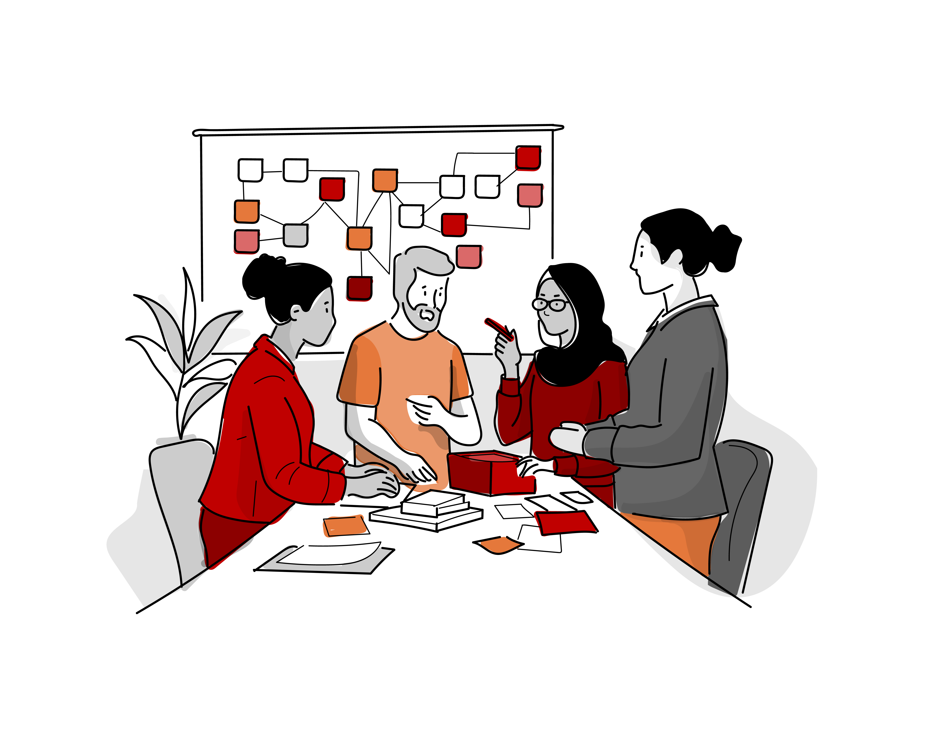
MAKE
PHASE

Slide 34
MAKE OBJECTIVES
Build tangible or physical manifestations of your solutions.
These manifestations are intended to help bring your idea to life, allow others to interact with it and provide feedback, answer specific questions about the concept, and test assumptions or hypotheses about the idea.
At the end of this phase, all team members should have a clear plan for conducting an experiment to learn more about the idea.
1. Storyboard
Your Idea
2. Brainstorm Assumptions
3. Assess
and Prioritize
Make Mindsets
Stay optimistic that you can solve the problem
Experiment early and often in order to learn about your idea
Start small to make big change
Show don't tell
Many cycles of experimentation are necessary to develop an idea
4. Choose Experiment Format
5. Choose Experiment
Strategy
6. MAKE Summary
121

Slide 35
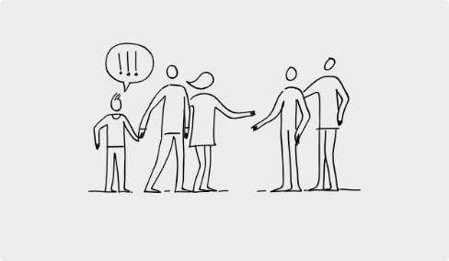
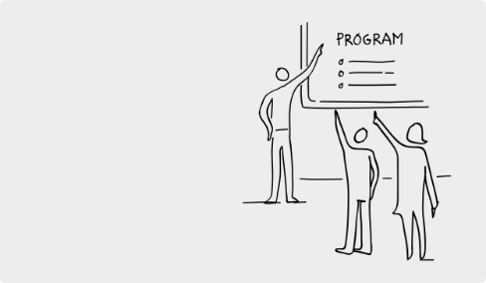

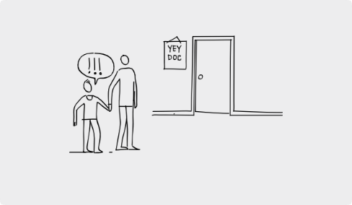


STORYBOARD
YOUR IDEA: SAMPLE
Break your idea down into smaller, actionable moments to better understand its details. One effective approach is to create a storyboard that illustrates how a user would interact with your idea step-by-step over time.
Identify key moments in the overall experience and how the stakeholder engages with your solution during these stages.
1
2
3
PHASE 1
Pre-experience
PHASE 2
Welcome Experience
PHASE 3
During Experience, Phase 1
.
THE KICK-OFF OF THE PROGRAM HAPPENS
ON A WEDNESDAY AFTER SCHOOL. STUDENTS COME TO GET ORIENTED TO THE PROGRAM.
JOE SHARES HIS CAREER GOALS WITH THE PROGRAM MANAGER.
JOE AND HIS PARENTS ATTEND A RECRUITMENT EVENT. JOE’S PARENTS SIGN HIM UP FOR THE PROGRAM.
What are your Assumptions?
What are your Assumptions?
What are your Assumptions?
JOE’S PARENTS WOULD BE ABLE TO ATTEND A RECRUITMENT EVENT.
JOE IS INTERESTED IN AN AFTERSCHOOL PROGRAM.
JOE IS ABLE TO ATTEND APPRENTICESHIP MEETINGS AFTER SCHOOL.
JOE HAS CAREER INTERESTS HE CAN SHARE WITH THE PROGRAM MANAGER.
4
5
6
PHASE 4
During Experience, Phase 2
PHASE 5
During Experience, Phase 3
PHASE 6
Post-experience
JOE LEARNS FROM HIS MENTOR ABOUT THE SKILLS REQUIRED FOR THE JOB
AT THE END OF THE PROGRAM, JOE REFLECTS AND SHARES
ABOUT WHAT HE LEARNED
JOE MEETS HIS MENTOR FOR THE FIRST TIME AND GOES TO HIS MENTOR’S OFFICE
What are your Assumptions?
What are your Assumptions?
What are your Assumptions?
JOE WILL CONNECT WITH AN ADULT WITH SHARED INTER- ESTS AND WILL OPEN UP ABOUT HIS GOALS
AN APPRENTICESHIP WILL HELP JOE MAKE CONNECTIONS TO HIS FUTURE
IF JOE PARTICIPATES IN AN APPRENTICESHIP HE WILL HAVE MORE SELF-EFFICACY

Slide 36
30 min
STORYBOARD
YOUR IDEA
Break your idea down into smaller, actionable moments to better understand its details. One effective approach is to create a storyboard that illustrates how a user would interact with your idea step-by-step over time.
Identify key moments in the overall experience and how the stakeholder engages with your solution during these stages.
1
2
PHASE 1
Pre-experience
PHASE 2
Welcome Experience
PHASE 3
During Experience, Phase 1
.
What are your Assumptions?
What are your Assumptions?
What are your Assumptions?
4
5
6
PHASE 4
During Experience, Phase 2
PHASE 5
During Experience, Phase 3
PHASE 6
Post-experience
What are your Assumptions?
What are your Assumptions?
What are your Assumptions?

Slide 37

30 min
ASSESS & PRIORITIZE ASSUMPTIONS
Take a moment to review the assumptions mapped against each step on your storyboard, considering
both the importance and the uncertainty of each assumption.
Make preliminary ratings for each assumption on both variables:
How important is this assumption to the success of your idea?
How known/understood is this assumption?
MOST IMPORTANT
Hold Off for now
Focus Here!!
MOST KNOWN
MOST UNKNOWN
Hold Off for now
Hold Off for now
MOST IMPORTANT

Slide 38
60 min
CHOOSE EXPERIMENT FORMAT & STRATEGY
Once you’ve identified the top 3 prioritized assumptions, identify the corresponding frame of the storyboard. As a team, redraw or describe the objective of that frame. Once completed and select the most suitable format for each assumption.
Prioritizing Assumption #1
Prioritizing Assumption #2
Prioritizing Assumption #3
Storyboard Frame
identify the corresponding frame of the storyboard for the assumption above
Storyboard Frame
identify the corresponding frame of the storyboard for the assumption above
Storyboard Frame
identify the corresponding frame of the storyboard for the assumption above
Choose Experiment Format
Choose Experiment Format
Choose Experiment Format
Choose Experiment Strategy
(Act it Out, Leave it Out, Try it Out)
Choose Experiment Strategy
(Act it Out, Leave it Out, Try it Out)
Choose Experiment Strategy
(Act it Out, Leave it Out, Try it Out)

Slide 39
20 min
MAKE PHASE SUMMARY
Document your MAKE Phase prioritization journey. This will ensure even after the workshop, each design team member has access to the decisions you made.
Which idea did you select/storyboarded for?
What were the key assumptions your prioritized?
1.
2.
3.
Which experiment format did you select?
1.
2.
What were the Choose Experiment Strategy
1.
2.
3.
121

Slide 40
CONGRATULATIONS
FOR COMPLETING
THE MAKE PHASE
Once your Design Team completes this phase, reflect on your experience on the process and how you feel at the end of this phase.

Slide 41

TEST
PHASE

Slide 42
TEST OBJECTIVES
Test your solution in your classroom and school community to gather feedback, answer specific questions about the concept, and test the assumptions or guesses you have made about your ideas.
While we will practice only one test during the session, you should aim to run multiple tests with learners and teachers in your classroom before you are ready to implement.
1. Practice a Test
2. Testing Plan
3. Reflection Grid
TEST Mindsets
Experiment early and often to learn about your idea.
Start small to create big change.
Show, don’t tell.
Many cycles of experimentation are necessary to develop an idea.
Feedback is a gift to improve your ideas.
4. What did you learn?
5. Now, What’s Next?
121

Slide 43
30 min
PRACTICE A TEST REFLECTION GRID
After practicing to test your prototypes & assumptions, use the following tool to reflect on the feedback shared by the stakeholders or any observations you made during the roleplay. Focus on these sections: what you liked, what changes need to be made, what questions were raised, and what ideas you observed.
Likes
What did you see or hear that is working well?
Changes
What did you see or hear that needs to be changed?
121
Questions
What did you see or hear that raised questions for you?
Ideas
What ideas came to mind as you observed or listened?

Slide 44
30 min
REFLECTION GRID
Use the following tool to reflect on the feedback shared by stakeholders or any observations you made. Focus on these sections: what you liked, what changes need to be made, what questions were raised, and what ideas you observed.
Likes
What did you see or hear that is working well?
Changes
What did you see or hear that needs to be changed?
121
Questions
What did you see or hear that raised questions for you?
Ideas
What ideas came to mind as you observed or listened?

Slide 45
30 min
REFLECTION GRID
Use the following tool to reflect on the feedback shared by stakeholders or any observations you made. Focus on these sections: what you liked, what changes need to be made, what questions were raised, and what ideas you observed.
Likes
What did you see or hear that is working well?
Changes
What did you see or hear that needs to be changed?
121
Questions
What did you see or hear that raised questions for you?
Ideas
What ideas came to mind as you observed or listened?

Slide 46
30 min
WHAT DID YOU LEARN?
Now it’s time to reflect, make choices and determine what’s next!
Use the provided tool to review each assumption you tested during the prototype session.
What did you learn?
Use the following tool to reflect on each assumption you tested. What did you learn and what will you
do next?
Assumption 1
What assumption was this experiment designed to test?
What did you learn about that assumption?
How will you change your solution based on what you learned?
Assumption 2
What assumption was this experiment designed to test?
What did you learn about that assumption?
How will you change your solution based on what you learned?
Discuss Learnings
Assumption 3
What assumption was this experiment designed to test?
What did you learn about that assumption?
How will you change your solution based on what you learned?
As a group, answer the following questions for each assumption:
What did you learn from the feedback
or observations?
What surprised you?
Decide how you will adjust or refine your prototype. Determine any new assumptions or questions
to test next time.
Assumption 4
What assumption was this experiment designed to test?
What did you learn about that assumption?
How will you change your solution based on what you learned?
Assumption 5
What assumption was this experiment designed to test?
What did you learn about that assumption?
How will you change your solution based on what you learned?
121

Slide 47
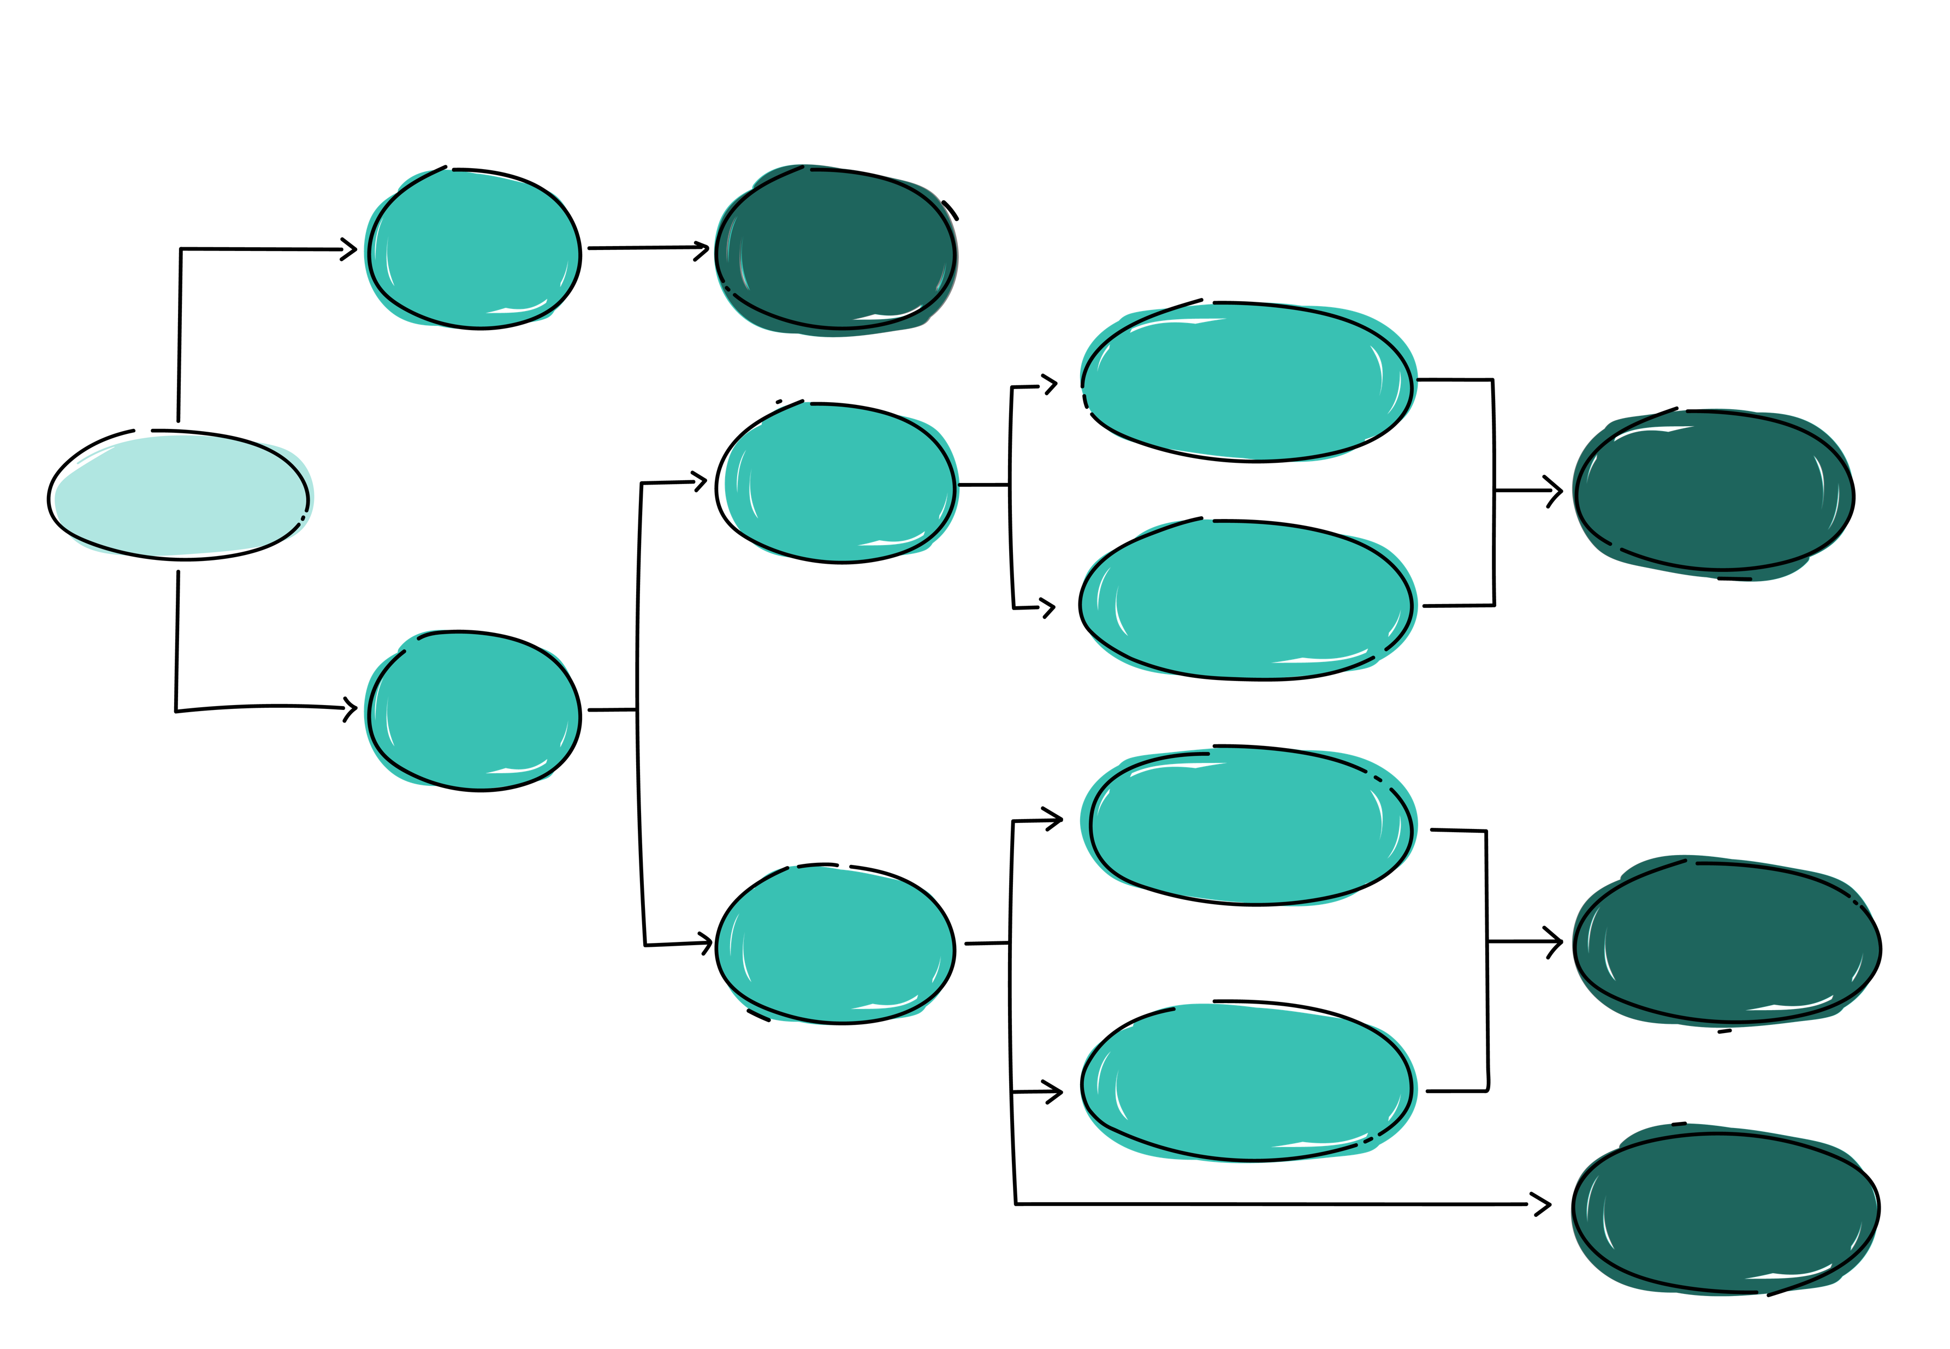
30 min
NOW WHAT’S NEXT?
Now it’s time to reflect, make choices and determine what’s next!
Use the provided tool to review each assumption you tested during the prototype session.
I tested some assumptions and still have questions about how it works
Continue Testing to Gather More Feedback & Improve Your Idea
The Solution did not solve
the problem (due to reasons such as wrong problem identification, doesn’t improve Learning Outcome)
Based on feedback from the stakeholder, you feel that this idea will not work
Pick the idea with the second highest scoring in the “Assess and Prioritize” Tool (Generate Phase)
I tested the Idea
The Solution did not work in the classroom (due to reasons such as lack of time, capability, student engagement, class dynamics)
I tested all the assumptions and don’t have more questions about how it works
Parts of the solution need to be redesigned to improve alignment with learning outcome / teaching practices
Based on feedback from the stakeholder, you feel that this idea will work
Go Back to “Idea Dashboard” Tool (Generate Phase) to Improve Solution and Continue Testing
Parts of the solution need be
redesigned to improve desirability / inclusivity / sustainability
Go to implementation

Slide 48
CONGRATULATIONS
FOR COMPLETING
THE TEST PHASE
Once your Design Team completes this phase, reflect on your experience on the process and how you feel at the end of this phase.

Slide 49
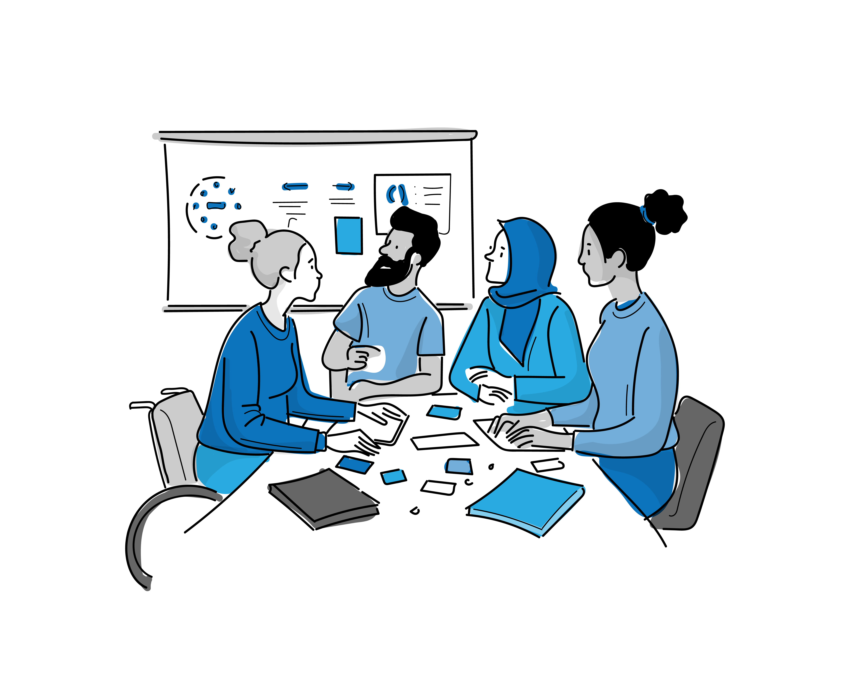
PLAN
PHASE

Slide 50
PLAN OBJECTIVES
You are moving from an idea you’re developing to a concept you are preparing to implement.
The goal of this phase is to align your design team around the next steps required to implement your concept if you were to receive funding. Consider your long-term goals for improving students' holistic learning outcomes.
It is important to transition from focusing only on what is desirable to also considering what is feasible and viable.
1. Plan Your
Intervention
PLAN Mindsets
Shift from idealism to realism by considering the resources, partnerships, and skills required to make the concept practical and sustainable.
Break down the concept into actionable steps with clear roles and responsibilities, ensuring alignment within the team.
Stay open to adjustments based on feedback or new insights, allowing the plan to evolve to meet real needs.
Look at how the solution could grow or adapt to benefit more stakeholders, aiming for long-term impact.
Identify key partners and resources needed, readying the team for effective communication and delegation..
121

Slide 51
15 min
TEST TEAM REFLECTION
As a team, take 15 min to reflect about the TEST Phase. It’s important to learn what your experiences were and how you could improve them next time.
A. What worked well
B. What Challenges did you experience?
C. What lessons have you learned through the testing experience?

Slide 52
CONGRATULATIONS
FOR COMPLETING
THE PLAN PHASE
Once your Design Team completes this phase, reflect on your experience on the process and how you feel at the end of this phase.

Slide 53
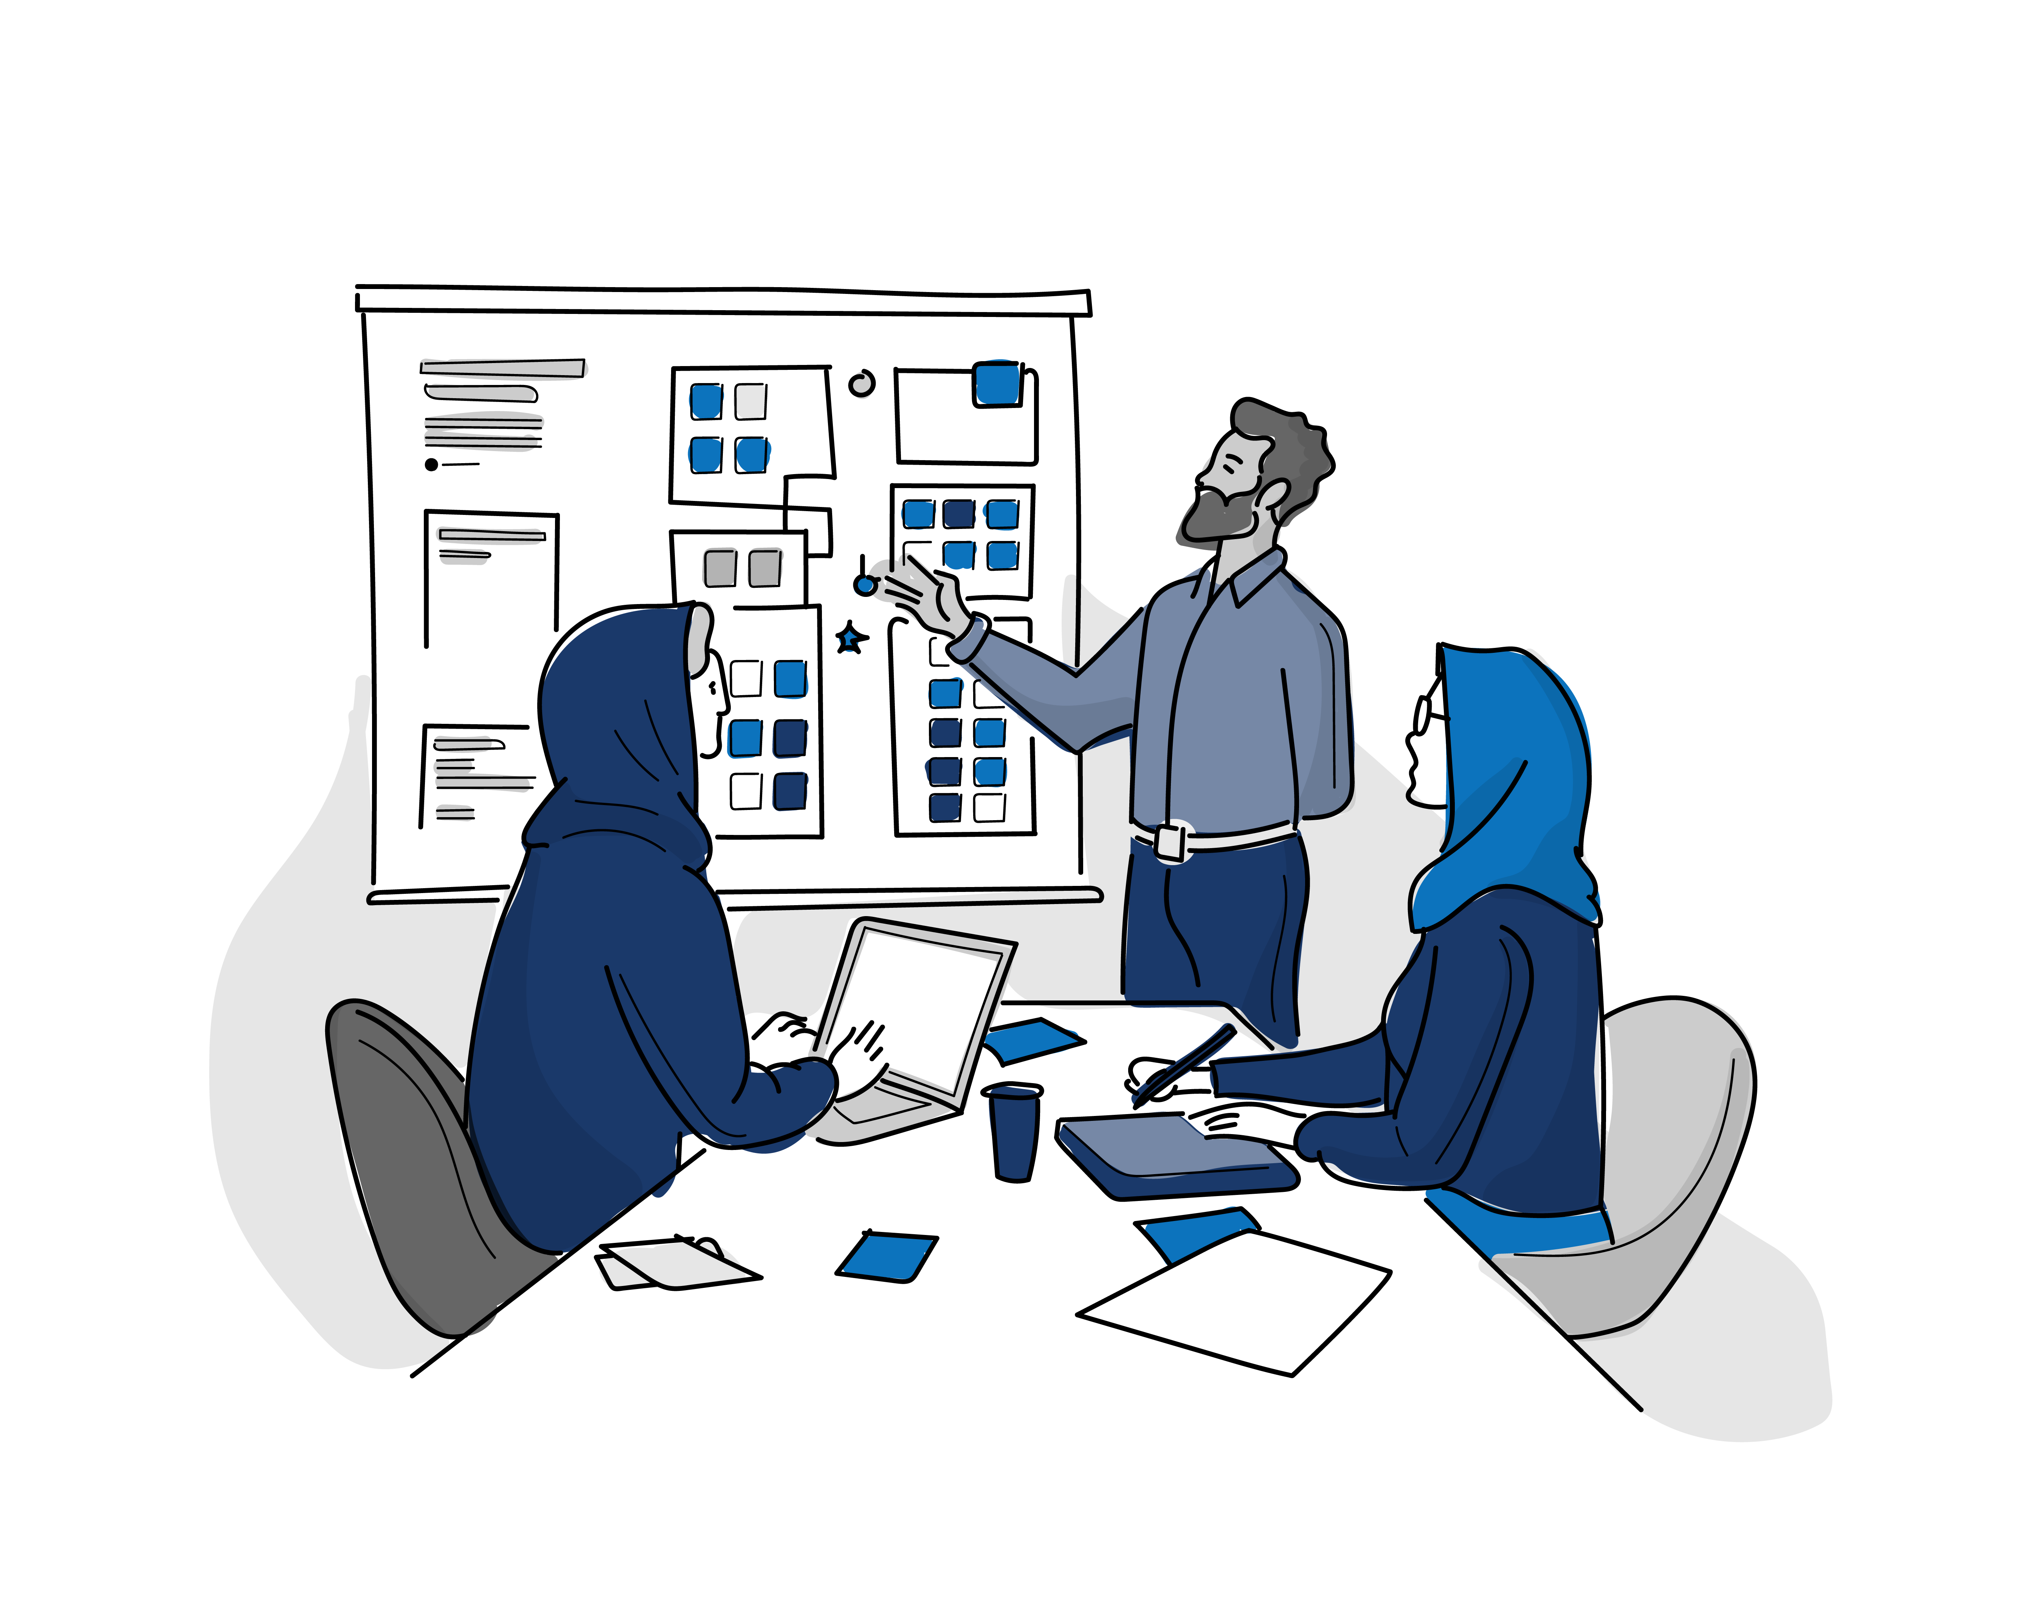
TELL
PHASE

Slide 54
TELL OBJECTIVES
Communicate what you learned about your solution and why it has the potential to meet the stakeholder’s needs
Synthesize what you learned from your design work and testing to share your insights and ideas in a human-centered way.
1. Develop
Your Story
2. TELL Summary
TELL Mindsets
Get inspired by people
Many cycles of testing are necessary to develop an idea
Feedback is a gift to improve your ideas and communication
121

Slide 55
60 min
DEVELOP YOUR STORY
Use this framework to help synthesize what you learned in the design challenge and communicate your idea in terms of the needs and emotions of your stakeholder. By using character-driven storytelling as the framework for synthesizing your learning and pitching a new concept, we find that we create more compelling and engaging pitches.
A story is different from a pitch because it focuses on the experiences and emotions of the stakeholder your solution is designed to serve. Focus your storytelling on the stakeholder who inspired your design work.
Connect what you learned from your design process to reasoning for why this solution is going to improve holistic learning outcomes.
1. WE MET…
Tell us more about your primary stakeholder.
2. WE NOTICED...
What was the surprising observation you made? What did you discover?
3. THEN WE LEARNED...
What concept did you create? What assumptions were you testing in your prototypes?
4. THEN WE LEARNED...
How have your prototypes evolved? What have you learned about your concept?
5. SO NOW WE HOPE TO IMPLEMENT…
What concept are you going to implement? What outcomes are you hoping for in terms of improving the outcomes for stakeholder?

Slide 56
CONGRATULATIONS
FOR COMPLETING
THE TELL PHASE
Once your Design Team completes this phase, reflect on your experience on the process and how you feel at the end of this phase.

Slide 57

01
02
03
04
LAUNCH PHASE
EXPLORE
PHASE
DEFINE
PHASE
GENERATE PHASE
05
06
07
08
MAKE
PHASE
TEST
PHASE
PLAN
PHASE
TELL
PHASE

Slide 58
www.schools2030.org | SCHOOLS 2030 HUMAN-CENTERED DESIGN SPRINT

