Slide 1



SCHOOLS2030 DESIGN SPRINT
PERSONAL
WORKBOOK
COUNTRY / DATE

Slide 3

ORIENTATION
Schools2030 Human-centered Design Sprint

Slide 4

INTRODUCTION
LET'S GET YOU STARTED
WHAT IS HUMAN-CENTERED DESIGN?
Human-centered design is a mindset and a creative approach for problem solving!
It's a process that starts with the people you're designing for and ends with new solutions that are tailor made to meet their needs.
Using the stakeholder-centered, iterative process of human-centered design can also provide helpful structures for designing more equitable solutions for all people, even those who are traditionally underrepresented.
By creating a community-driven collaborative process that engages stakeholders in the work of co-creation and iterative feedback, human-centered design can help to identify solutions that will solve real problems and meet important (but sometimes misunderstood) needs.
HUMAN-CENTERED DESIGN MINDSETS
The goal of mindsets is to help us move away from our usual way of thinking and doing to embrace new problem-solving and critical thinking skills.
Each Phase of the design process will have a few key mindsets to remind you to push yourself and to remain focused on the task at hand
Work together to understand the context
Look carefully to understand potential problems and opportunities
Stay optimistic that you can solve the problem
Hold back on solving the problem until the time is right
Get inspired by people - active listening is a source of creative inspiration
Put aside biases and assumptions about what you think the problem is - listen to the stakeholder.
Seek new perspectives on old problems
See opportunities in constraints
Get comfortable with navigating contradictory information
Many ideas lead to good ideas
Defer judgment and criticism of ideas until the time is right
Idea generation is not the time for evaluating ideas
Brainstorming is a collaborative team activity
Allow yourself to think of wild ideas
Prototype early and often in order to learn about your idea
Start small to make big change
Show don’t tell
Many cycles of prototyping are necessary to develop an idea
Feedback is a gift to improve your ideas
HUMAN-CENTERED DESIGN IN SCHOOLS
Human-centered design methodologies have gained increasing attention in K12 education in recent years. From educators using the process as a pedagogical framework for real world, project-based learning to school leaders leveraging the process as a driver of innovation, progressive leaders of education reform around the world have taken up human-centered design as a mechanism for positive change.
As we build awareness that school systems are complex human-centered environments that are actively designed, we continue to see the desire to equip leaders and teams with tools that are used by professional designers in order to creatively solve problems and actively imagine new futures.
121

Slide 5

PHASES OF THE DESIGN PROCESS & WHAT IS INCLUDED IN THE TOOLKIT
KEY
For this project, there are eight phases. Each phase has different tools and activities that you and your design team will need to complete in order to move to the next phase.
During your design journey, you will be provided with 2 workbooks:
A4 Personal Design Workbook – This workbook is for activities that require you to provide your personal experience as an educator, knowledge about your classroom environment and insights about your learners. It will also provide you with tools for self-reflection and capturing your thoughts before sharing them with the rest of your team.
An A3 Design Team Workbook – This workbook will provide you with tools that bring your collective thoughts, experiences and ideas together, guide you as a team to achieve joint objectives and a space to summarize and document your collective design decisions.
Welcome to your Personal Design Workbook.
Within each workbook are specific tools that you will fill in or use. See below for a list of the phases and tools included in both the Personal and Team workbooks.
The Tools Highlighted in Blue are the only tools you will use in this workbook.
Throughout the workbook, at the beginning of each phase, there is an introduction page with context and goals for the phase and a highlight of the tools. On top of each tool, there will be an icon that highlights personal vs group activities. Your Design Facilitator will provide you with instructions on how to complete the activities & tools before using them, but incase you are in doubt, always seek clarification. We are on this journey together.
Personal Activity
Group Activity
OUR DESIGN JOURNEY
1
2
3
4
LAUNCH
1. Classroom Data Walk and Reflection – LO
2. Prioritize Learning Outcome
3. Select Learning Outcome Sub-Domains
4. Classroom Data Walk and Reflection – LE
5. Select Learning Environment Practices
6. LAUNCH Summary
EXPLORE
1. Who are we going to engage?
2. What are we going to ask?
3. Interview Role Play
4. Make a research plan
5. How To Take Interview Notes
DEFINE
1. Research Reflection & Synthesis
2. Thematic Clustering
3. Generate Insights from Themes
4. Define How Might We Question
5. Align HMW with LO and LE
GENERATE
1. Brainstorming Ideas
2. Assess and Prioritize
3. Learn from Others
4. Idea Dashboard
5
6
7
8
MAKE
1. Storyboard Your Idea
2. Brainstorm Assumptions
3. Assess and Prioritize
4. Choose Experiment Format
5. Choose Experiment Strategy
6. MAKE Summary
TEST
1. Practice a Test
2. Testing Plan
3. Reflection Grid
3. What did you learn?
4. Now what’s next?
PLAN
1. Plan Your Intervention
TELL
1. Develop Your Story
2. TELL Summary
121

Slide 6
GLOSSARY OF TERMS
As you work through this toolkit, you may encounter new words or phrases.
Use the glossary to help define those words.
Assumption: A person’s beliefs that are not based on facts or evidence.
Brainstorm: A process for creating a large number of ideas.
Concept: A robust idea that has been developed through multiple rounds of prototyping.
Equity: An approach where every person, regardless of who they are, is given what she or he needs in order to survive and thrive.
Fieldwork: The work that you will complete independently through interviewing students and families and testing prototypes in the classroom and beyond.
Generate: The process of creating something.
Headline: A brief (few words) description –
just like a newspaper headline.
HMW: How Might We is a question structure used in brainstorming. It emphasizes the collaborative and exploratory nature of brainstorming,
Inequity: A circumstance in which some people get more resources than others; those with less do not have what they need to survive and thrive.
Iterate: Make improvements to an idea based
on feedback.
Needs: The motivations or desires of a stakeholder.
Pilot: The beginning of implementing an initiative when the idea is still being developed and refined.
POV: A Point of View statement is a framework for communicating the new problems and needs of a specific stakeholder.
Prototype: An early experiment that allows you to test your idea before investing a lot of time and money. A series of prototypes happen before a pilot.
Quantitative Data: Communicating information through numerical representation.
Qualitative Research: Information gathered
from interacting with those whom you are trying
to understand.
Reflection: The process of thinking about
your own work in order to improve it.
Resolution: The amount of effort and resources required to reach a certain standard of craftsmanship.
Scale: The number of stakeholders that
a solution reaches.
Sketch: A quick, imperfect drawing that helps
you visualize your ideas.
Solutions: An intervention that, through
your design work, you believe will meet
the needs of the stakeholder.
Stakeholders: The people for whom you are designing.
Synthesize: He process of analyzing information in order to make sense of it and find new meanings.
Test: The process of trying out your prototype
with real stakeholders in order to learn more
about the solution.
Workshop: The opportunity to convene in a larger group - either regional or school-based - to do collaborative design work.

Slide 7

LAUNCH
PHASE

Slide 8
LAUNCH PHASE
LAUNCH OBJECTIVES
The goal of the Launch phase is to collectively review and reflect on the assessment data to determine the holistic learning outcomes (LO) you will improve in your classroom. The prioritized learning outcome should align with the needs of your learners, the goals of the school administration, and local values, beliefs, and interests.
Participants then work in teams to further narrow their focus based on a detailed review of the sub-domains of learning outcomes data.
LAUNCH MINDSETS
Work to understand the data
Look closely to understand potential problems and opportunities
Stay optimistic that you can solve the problem
Hold back on solving the problem during this phase
Be open to new perspectives
1. Classroom Data
Walk and Reflection –
Learning Outcomes
2. Prioritize Learning Outcome
3. Select Learning
Outcome Sub-Domains
4. Classroom Data
Walk & Reflection – Learning Environment
5. Select Learning Environment Practices
6. Launch
Summary
121

Slide 9


15 min
REFLECT ON YOUR CLASSROOM DATA: LEARNING OUTCOME
On Your Own: Take out your previous classroom assessment or the previous class’s if it’s a new class. Think and reflect on your classroom assessment results
ECD
Secondary schools
How are your learners doing in literacy and numeracy?
How are your learners doing in the other three learning domains?
1. Literacy
3. Holistic Learning Domains #3
4. Holistic Learning Domains #4
2. Numeracy
5. Holistic Learning Domains #5
121

Slide 10
15 min
CLASSROOM DATA WALK &
REFLECTION: LEARNING OUTCOMES
What learning outcomes are scoring High? Low? Medium?
Why is that happening?
Are you surprised?
Does the data reflect your classroom?
These 2 questions give us an idea of how the classroom data you saw corresponds with your classroom. In the next 2 activities, Let's dig a bit deeper and make sense of the data & your reflection.
121

Slide 11
15 min
CLASSROOM DATA WALK &
REFLECTION: LEARNING OUTCOMES
ECD
Secondary schools
On Your Own: Think and reflect how the assessment results apply to your classroom
What learning outcomes are your learners having the most challenges with?
What surprises you?
Are they the same or different to the assessment results?
What questions do you have?
Discuss your responses with a partner
121

Slide 12
15 min
PRIORITIZE CORE
LEARNING OUTCOME
Use this framework to assess the holistic learning outcomes by placing them in different sections of the graph as you think they belong. Once completed, reflect on which learning outcome domains in the bottom-right quadrant (High Recurrence, Low Performance) should be the focus for improvement.
In pairs, discuss each learning outcome domain, considering both the recurrence and the performance
of students in each domain.
Make preliminary ratings for each learning outcome domain on both variables:
How persistent has this LO been a challenge for your learners?
How well are students currently performing in this domain?
Good Student Performance
Not a recurring challenge.
Might be a new challenge or has been resolved in the past.
Recurring challenge
Despite your best efforts, this has been a continues challenge for your learners
(High Recurrence,
Poor Performance): Priority areas for improvement.
Poor Student Performance
121
5 MIN
120

Slide 13
Pre-primary Learning Environment Behaviours and Characteristics
Brief Early Childhood Quality Inventory (BEQI)
PLAY-BASED LEARNING
Children have some choice in how to carry out activities
Children have free choice/open play time
During free choice/open play time, the teacher engages in play with children
Children read or look at books on their own
Children engage in pretend play
Children go outside
Children work in pairs/small groups
Children work one-on-one with teacher
Children spend a balance of time in free play and teacher-led activities
Teacher uses concrete materials to teach a concept
Children engage with concrete materials during activities/lessons
Children engage with writing materials
Children engage with art materials
Children engage with pretend play materials
Children engage with blocks
Children engage with math materials
Age-appropriate books are available
LEARNING THROUGH CONVERSATION
When children are playing, teacher builds on what children are doing (”teachable moments”)
Teacher reads a storybook
Teacher defines words and verbally labels items
Teacher asks open-ended questions
Teacher asks questions or uses strategies to check for the majority of children’s understanding
Children have opportunity to generate ideas, share opinions and ask questions
Teacher engages in a back-and-forth discussion
Teacher connects a lesson to real-life or every-day experiences
Teacher connects a lesson to real-life or every-day experiences
PROMOTING STRONG RELATIONSHIPS
Teacher treats all children equally
Teacher integrates respect for diversity
Teacher helps children make ethical or socially acceptable choices
Teacher gets on children's level
Teacher invites children to share personal experiences
Teacher talks about feelings or emotions
Teacher provides individualized feedback related to children’s learning
Teacher reengages children when they are distracted or uninterested in activity
Teacher acknowledges positive behavior
Teacher redirects misbehavior by focusing on the expected behavior
Teacher does not punish any child physically
Teacher does not have negative verbal interactions with a child
Teacher does not leave children alone
121
5 MIN
120

Slide 14
Primary and Secondary Learning Environment Behaviours
Valuing Inclusive Teaching And Learning (VITAL)
A. SPPORTIVE LEARNING ENVIRONMENT |  |  | QUALITY TEACHING & LEARNING PRACTICES | QUALITY TEACHING & LEARNING PRACTICES
1. EMOTIONAL CLIMATE | 2. HIGH EXPECTATIONS | 2. HIGH EXPECTATIONS | 3. FACILITATING LEARNING | 3. FACILITATING LEARNING | 4. CRITICAL THINKING & CREATIVITY | 4. CRITICAL THINKING & CREATIVITY
1.1. The teacher treats all students respectfully. | 2.1. The teacher communicates the highest behavioural expectations for learning activities. | 2.1. The teacher communicates the highest behavioural expectations for learning activities. | 3.1. The teacher explicitly articulates the expected learning outcomes of the lesson and relates learning activities to these. | 3.1. The teacher explicitly articulates the expected learning outcomes of the lesson and relates learning activities to these. | 4.1. The teacher asks open-ended questions (that require reasoning, explanation, generalization or have more than one correct answer). | 4.1. The teacher asks open-ended questions (that require reasoning, explanation, generalization or have more than one correct answer).
1.2. Teacher and student interactions are positive. | 2.2. The teacher acknowledges positive student behaviour. | 2.2. The teacher acknowledges positive student behaviour. | 3.2. The teacher explains concepts and content clearly. | 3.2. The teacher explains concepts and content clearly. | 4.2. Students are happy to ask questions, including open-ended questions’. | 4.2. Students are happy to ask questions, including open-ended questions’.
1.3. The teacher responds to students’ emotional, physical and materials needs. | 2.3. The teacher redirects misbehaviour by focusing on the expected behaviour. | 2.3. The teacher redirects misbehaviour by focusing on the expected behaviour. | 3.3. The teacher relates the lesson to previous learning, other content knowledge and/or students' daily lives. | 3.3. The teacher relates the lesson to previous learning, other content knowledge and/or students' daily lives. | 4.3.The teacher provides thinking tasks (that require students to actively analyse content as opposed to rote learning). | 4.3.The teacher provides thinking tasks (that require students to actively analyse content as opposed to rote learning).
1.4. The teacher does not exhibit bias (e.g., gender, disability, colour, ethnicity, linguistic or socio-economic background). | 2.4. The teacher helps students make ethical and socially acceptable choices. | 2.4. The teacher helps students make ethical and socially acceptable choices. | 3.4. The teacher uses a variety of appropriate learning strategies, tasks and materials. | 3.4. The teacher uses a variety of appropriate learning strategies, tasks and materials. | 4.4. The teacher provides activities that encourage student initiative, curiosity, imagination, creativity and/or learning through play, and integrates digital technologies where available and appropriate, (e.g., use of art and craft/design, movement, drama, music, poetry and playful pedagogies such as experiential learning, games, inquiry, problem-solving, project-based learning and use of outdoor activities). | 4.4. The teacher provides activities that encourage student initiative, curiosity, imagination, creativity and/or learning through play, and integrates digital technologies where available and appropriate, (e.g., use of art and craft/design, movement, drama, music, poetry and playful pedagogies such as experiential learning, games, inquiry, problem-solving, project-based learning and use of outdoor activities).
1.5. The teacher challenges stereotypes (e.g., gender, disability, colour, ethnicity, linguistic or socio-economic background). | 2.5. The teacher provides opportunities for students to take on meaningful roles in the classroom. | 2.5. The teacher provides opportunities for students to take on meaningful roles in the classroom. | 3.5. The teacher provides students with choices. | 3.5. The teacher provides students with choices.
 |  |  | 3.6. The teacher adjusts teaching and provides activities relevant to the level of the students.
1.6. Students demonstrate sensitivity, empathy and respect towards each other and are willing to help peers who are distressed. |  |  | 3.6. The teacher adjusts teaching and provides activities relevant to the level of the students. | 3.6. The teacher adjusts teaching and provides activities relevant to the level of the students.
 |  |  | 3.7. The teacher provides a beginning, middle and end to the lesson with good sequencing and pacing. | 3.7. The teacher provides a beginning, middle and end to the lesson with good sequencing and pacing.
 |  |  | 3.8. Students are engaged in learning activities. | 3.8. Students are engaged in learning activities.
QUALITY TEACHING & LEARNING PRACTICES Contd.
5. SOCIAL & COLLABORATIVE LEARNING |  | 6. LEARNING TO LEARN |  | 7. CHECKS FOR UNDERSTANDING |  | 8. FEEDBACK
5.1. The teacher uses collaborative pair and group work effectively. |  | 6.1. The teacher models learning to learn and/or offers guided instruction to help students think through how they will approach a task. |  | 7.1. The teacher uses questions, prompts, or other strategies to determine students’ level of understanding. |  | 8.1. The teacher provides genuine specific comments that help identify students’ successes.
5.2. The teacher helps students find ways to resolve conflict and reach agreements. |  | 6.2. The teacher responds positively to student challenges. |  | 7.2. The teacher monitors students during independent and group work. |  | 8.2. The teacher provides specific comments or prompts to clarify students’ misunderstandings.
5.3 The teacher integrates a respect for diversity into lesson content and delivery (e.g. respect for diverse perspectives, opinions, peoples, ethnicities, abilities or 'disabilities', geographies, cultures, contexts, beliefs, languages etc.) |  | 6.3. Students seek clarification and support. |  | 7.3. The teacher acknowledges and focuses on students’ efforts and attitudes, (rather than focusing on results, perceived intelligence or 'natural abilities'). |  | 8.3. The teacher provides opportunities for students to give constructive feedback to one another.
 |  | 6.4. The teacher provides opportunities for self-assessment and /or peer assessment.
 |  | 6.5. The teacher provides opportunities for students to set their own goals
121
5 MIN
120

Slide 15
20 min
LAUNCH PHASE SUMMARY
Design Team Name:
Design Team Roles & Responsibilities :
My prioritised Learning Outcome is:
My selected sub-domains are:
1.
2
My selected learning environment practices are:
1.
2.
121

Slide 16
CONGRATULATIONS
FOR COMPLETING
THE LAUNCH PHASE

Slide 17

EXPLORE PHASE

Slide 18
EXPLORE PHASE
EXPLORE OBJECTIVES
Engage with the most relevant (and most underrepresented) stakeholders in your school who are connected to the problem
you are working to solve.
We will use specific design research methods to learn more
about the needs, experiences, emotions, and motivations
of the stakeholders for whom you are designing.
These activities will help the team see the problem from the perspective of the stakeholders most affected by it.
By the end of this phase, all team members should have conducted
ten interviews (at least five with students) and captured notes from those interviews.
EXPLORE MINDSETS
Get inspired by people - active listening
is a source of creative inspiration
Put aside biases and assumptions about what you think
the problem is - listen to the stakeholder.
Look carefully to understand potential problems and opportunities
Stay optimistic that you can solve the problem
Hold back on solving the problem during this phase
1. Who are we going to engage?
2. What are we going to ask?
3. Interview Role Play
4. Make a research plan
5. How to take interview notes?
121

Slide 19



20 min
WHO ARE WE GOING TO ENGAGE?
The goal of this exercise is to identify and specify the names of individuals within each stakeholder group (students, parents, and teachers) who will participate in research interviews and observations. The exercise aims to ensure a diverse and representative sample of perspectives related to the research topic.
Brainstorm and list names of specific individuals within each stakeholder group (Students, Parents, Teachers) who could provide valuable insights for the research.
Ensure that the overall list includes a balanced representation of perspectives from students, parents,
and teachers. diverse representation is also a key part of your selection (e.g., different grades
for students, various roles for teachers).
  STUDENTS
  FAMILY
  SCHOOL STAFF (Teacher, Head teacher)
Interview #1
Name:
Reason for selection:
Interview #1
Name:
Reason for selection:
Interview #1
Name:
Reason for selection:
Interview #2
Name:
Reason for selection:
Interview #2
Name:
Reason for selection:
Interview #2
Name:
Reason for selection:
Interview #3
Name:
Reason for selection:
Interview #3
Name:
Reason for selection:
Interview #3
Name:
Reason for selection:
121

Slide 20
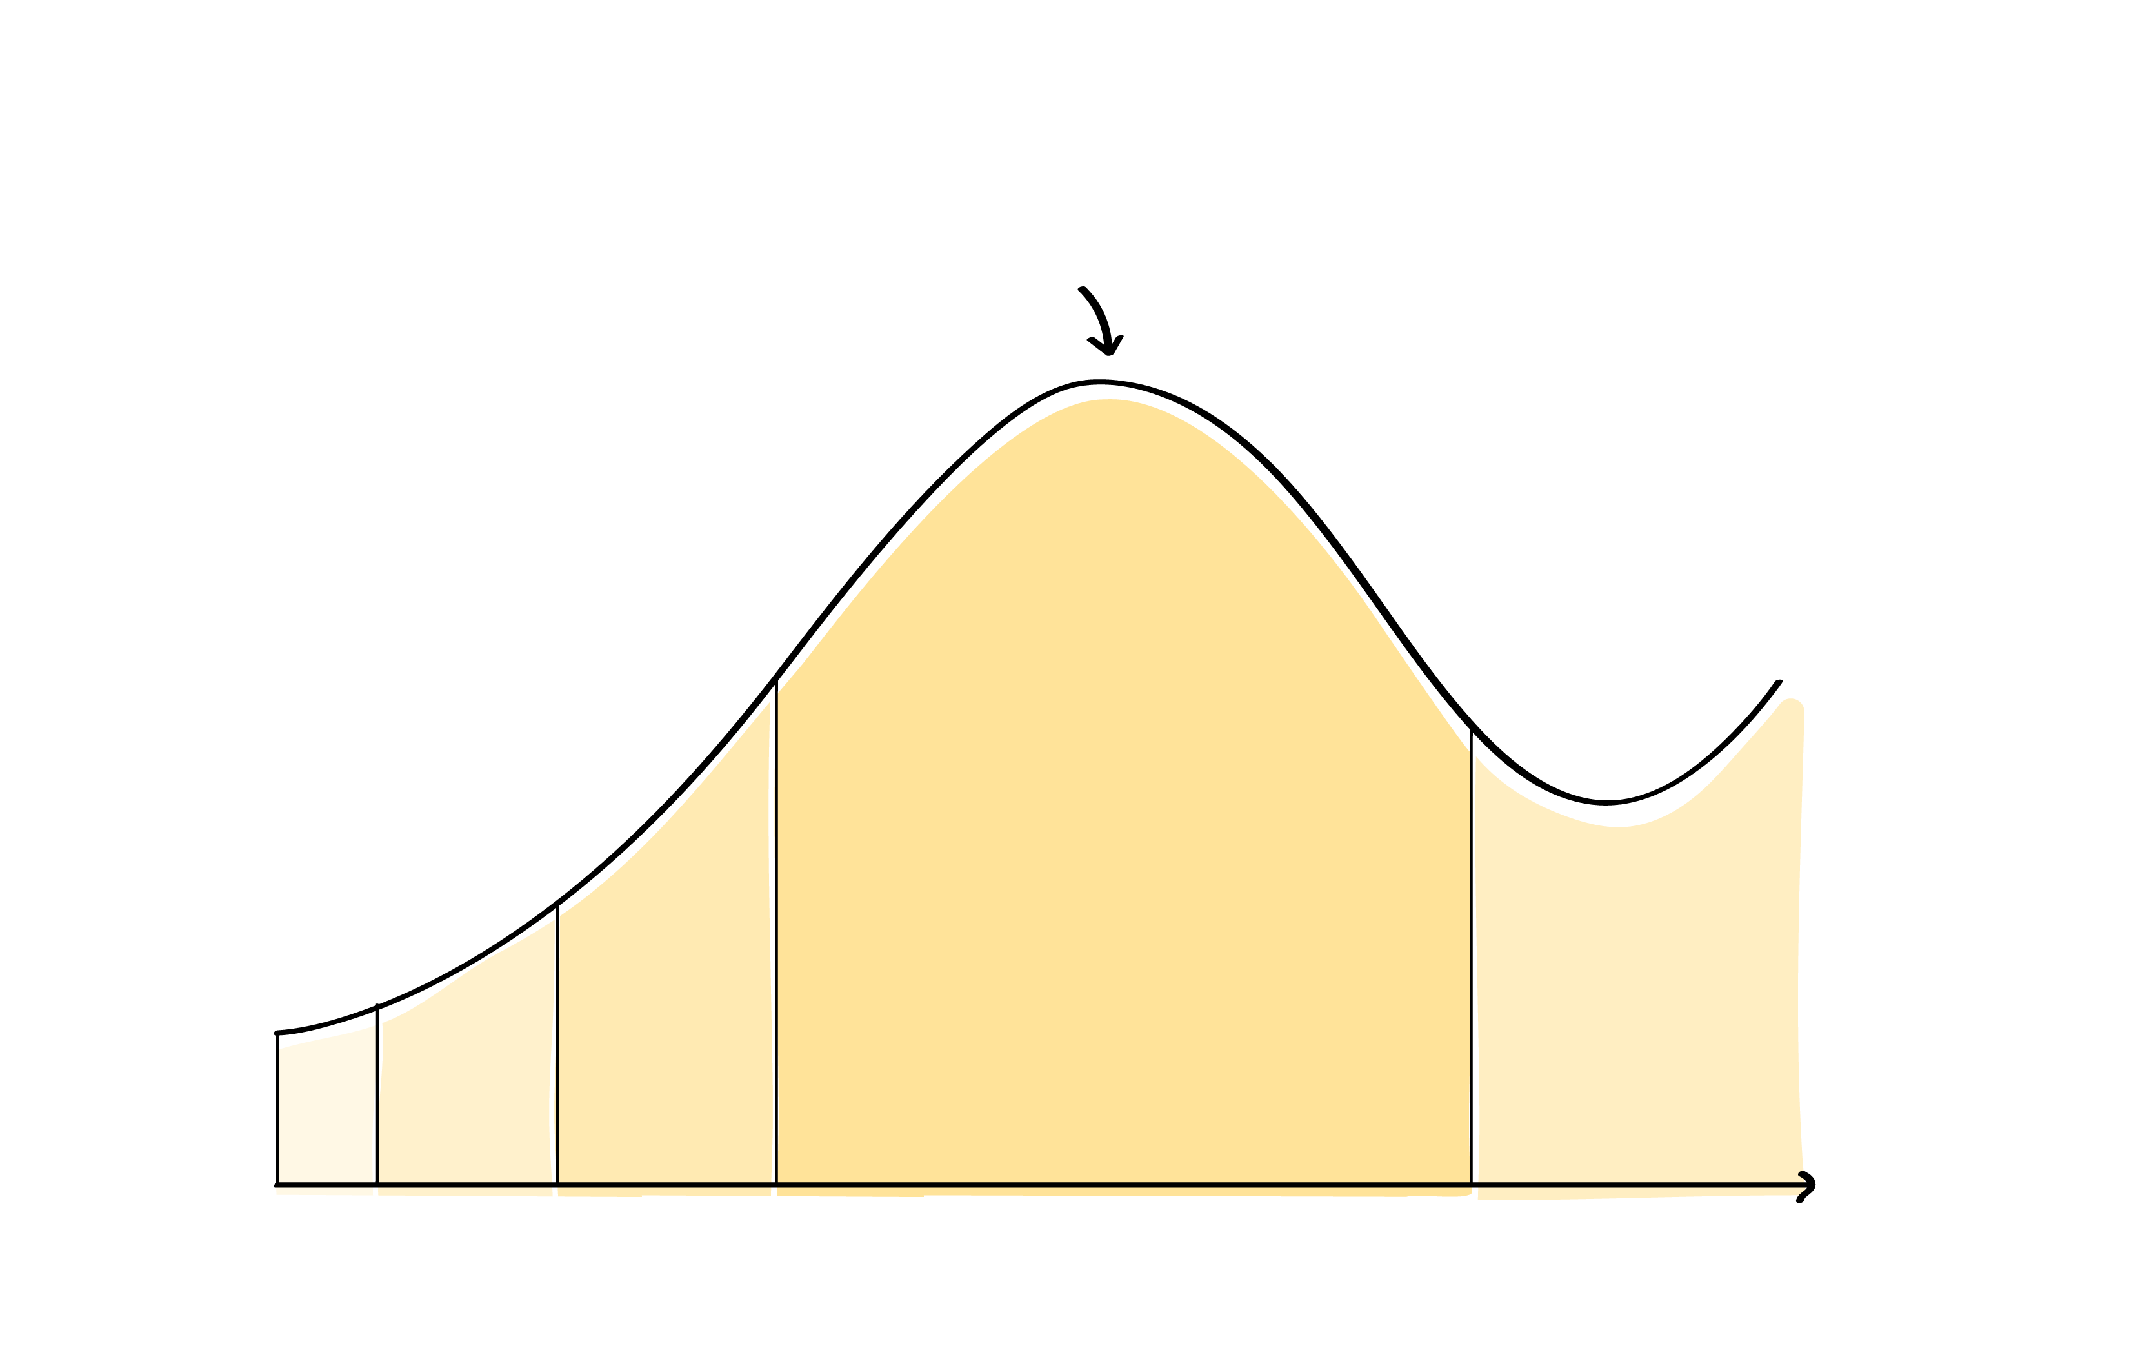
WHO ARE WE GOING TO ENGAGE?
The interview arc is a guided process that provides an overview of how to set up conduct and end an interview. It gives us, a visual representation of the interviewer’s (you) journey as they interact with their interviewee. Always remember, every interview is an arc
INTERVIEW ARC
HOW TO DO IT: INTERVIEW ARC
This line represents the amount of energy
or effortThat should be allocated in
that part of the interview
Every interview has an arc - A Beginning, Middle & End. Start by introducing yourself and your project.
Ask a few easy questions. E.g. Tell me a little about yourself. What do you love to do in your free time?
Ask open-ended questions that elicit stories. E.g. Tell me about your favorite class in school.
Don’t offer answers to your own questions.
Follow up on interesting things that you hear or observe. You could reflect what you hear back such as "That makes you happy" -this can lead to the stakeholder offering more information. Look for body language cues, listen for pauses, nervous laughter, etc. You could build on this by saying e.g. that seems to make you feel nervous or shy to which the stakeholder may confirm or clarify,
Talk about feelings. E.g. Tell me more. What did you mean when you said that?
Look for the deeper “why.” Dig deep to really understand what motivates your stakeholder while being sensitive to their emotional boundaries. A good way to ask “why” is to say, “Tell me more about...”
Don’t be afraid of silence. Often the person will fill the silence with a deeper thought.
Seek stories
Follow up
Is there anything else you would like to share
Build rapport
Wrap up
Introuce the project
Introduce yourself
Most questions & Time
TIME
121

Slide 21
10 min
WHAT ARE WE GOING TO ASK?
The goal is to create a set of interview questions for each stakeholder group (students, teachers, parents) using
an ’Interview Questions’ starter list and supplementing it with additional questions tailored to the specific learning outcome and research questions.
As a design team, start by reviewing Interview Questions list for each stakeholder group from the research workbook on page X. You do not need to ask all the questions. Pick 5 that are most relevant to start. You can also modify the questions as needed.
For each stakeholder group, brainstorm additional questions that are pertinent to your specific learning outcome, learning environment practice and research questions.
  STUDENTS
Additional Questions
Include several questions about the holistic learning outcomes
you are hoping to increase:
1.
2.
3.
4.
5.
Additional Interview Techniques
What other interview techniques would you like to incorporate in your research? i.e. Shadowing, Card sorting, Emotional Chats
Starter Questions
Can you tell me about the different activities you are involved in at school? What do you enjoy most about them?
What do you like to do outside of school? Are there any hobbies or interests you are passionate about?
What is your favourite subject in school? What makes it exciting or meaningful to you
Is there a subject that you find challenging or don’t enjoy working on? What makes it difficult or frustrating for you?
Tell me about a school project that you really enjoyed working on. What made it so interesting or fun?
Can you share a project or assignment where you learned something really valuable? What was the biggest lesson you took from it?
If you could learn anything that isn’t currently taught in school, what would it be? Why is that topic important or exciting to you?
Have you had a moment when something you learned in school connected to your future goals or dreams? What was that experience like?
What are some of your goals for future? How do you see school helping you achieve them?
Can you think of a time when you used something you learned in school in your everyday life? How did it help you?
Do you ever see connections between the things you learn in different classes? Can you share an example of when that happened?
  Some question might need to be modified to meet a specific stakeholder. Use this space to modify the questions
At the end of the interview, always ask this final question:
Is there anything more you would like to share with me?
121

Slide 22
10 min
WHAT ARE WE GOING TO ASK?
The goal is to create a set of interview questions for each stakeholder group (students, teachers, parents) using
an ’Interview Questions’ starter list and supplementing it with additional questions tailored to the specific learning outcome and research questions.
As a design team, start by reviewing Interview Questions list for each stakeholder group from the research workbook on page X. You do not need to ask all the questions. Pick 5 that are most relevant to start. You can also modify the questions as needed.
For each stakeholder group, brainstorm additional questions that are pertinent to your specific learning outcome, learning environment practice and research questions.
  SCHOOL STAFF
Additional Questions
Include several questions about the holistic learning outcomes
you are hoping to increase:
1.
2.
3.
4.
5.
Additional Interview Techniques
What other interview techniques would you like to incorporate in your research? i.e. Shadowing, Card sorting, Emotional Chats
Starter Questions
Can you walk me through the different activities you are involved in at school? What do you enjoy most about them?
Outside of school, what kind of activities or interests do you pursue? How do they influence your work with students?
What do you enjoy doing in your free time? How does it help you recharge or inspire your teaching?
Is there a class or subject you have particularly enjoyed teaching this year? What made it especially engaging for you and your student
Have there been any classes or subjects that were more challenging to teach this year? What made them difficult and how did you approach those challenges?
Can you tell me about a project or lesson that you really loved teaching? What made it stand out for you?
Is there a particular project where you felt student learned the most? What do you think contributed to their success?
If you had the opportunity to teach something new or different, what would it be? Why do you think it would be valuable for students?
Can you share a moment when you saw students making connections between what they learned in class and their future goals? What impact did that have?
What are some of the key goals you have for your student's learning and growth? How do you work towards achieving them?
  Some question might need to be modified to meet a specific stakeholder. Use this space to modify the questions
At the end of the interview, always ask this final question:
Is there anything more you would like to share with me?
121

Slide 23
10 min
WHAT ARE WE GOING TO ASK?
The goal is to create a set of interview questions for each stakeholder group (students, teachers, parents) using
an ’Interview Questions’ starter list and supplementing it with additional questions tailored to the specific learning outcome and research questions.
As a design team, start by reviewing Interview Questions list for each stakeholder group from the research workbook on page X. You do not need to ask all the questions. Pick 5 that are most relevant to start. You can also modify the questions as needed.
For each stakeholder group, brainstorm additional questions that are pertinent to your specific learning outcome, learning environment practice and research questions.
  FAMILY
Additional Questions
Include several questions about the holistic learning outcomes
you are hoping to increase:
1.
2.
3.
4.
5.
Additional Interview Techniques
What other interview techniques would you like to incorporate in your research? i.e. Shadowing, Card sorting, Emotional Chats
Starter Questions
Can you tell me about the activities you are involved in at your child's school? How would you describe or visualise your child relationship with learning or school? Why?
When your child talks about their school day, what do they usually share with you? Are there any moments that stand out?
What is your child's favourite class this year? What do you think makes it enjoyable for them?
Is there a class your child finds challenging or less enjoyable? What do you think contributes to that?
Can you tell me about a project where you felt your child learned the most? What made it a meaningful experience for them?
If your child could learn about something that isn't currently taught in school, what would you wish that would be? Why do you think its important?
Have you ever seen your child make a connection between what they learned in school and their future? Can you describe that moment?
What are your hopes and goals for your child's learning? How do you support them in achieving these goals?
What dreams or inspirations do you have for your child's future? How do you see education playing a role in that?
Looking back, how would you describe your own childhood? In what ways do you see similarities or differences in your child's experiences in school?
Do you experience any challenges supporting your child with their school work? Why do you think that is?
How would you describe or visualise your relationship with your child's teachers? Why?
  Some question might need to be modified to meet a specific stakeholder. Use this space to modify the questions
At the end of the interview, always ask this final question:
Is there anything more you would like to share with me?
121

Slide 24



60 min
INTERVIEW NOTES
When you are observing, interviewing or engaging, be sure to take notes on what you hear and notice about the participant. Write specific information and exact quotations.
Role Play Activity
Documentation Tips
When you are observing, interviewing or engaging, be sure to take notes of what you see, hear and notice about the participant.
Pay attention to the emotions as they respond to your questions and as you observe them
Write specific information and exact quotations.
What did you hear?
What did you see?
What emotions did you observe?
Stakeholder Details
Name:
Gender:
Group:
Research Approach:
Place:
121

Slide 25
30 min
MAKE A RESEARCH PLAN
The goal of this exercise is to identify and specify the names of individuals within each stakeholder group (students, parents, and teachers) who will participate in research interviews and observations. The exercise aims to ensure a diverse and representative sample of perspectives related to the research topic.
Interviewee Details: Name & Gender | Stakeholder Group (Students, Parents, Teachers) | Research Approach (interview, observe, creative – draw, story tell, card sort) | PLACE | DATE | DURATION

Slide 26
10 min
INTERVIEW NOTES
When you are observing, interviewing or engaging, be sure to take notes on what you hear and notice about the participant. Write specific information and exact quotations.
Interview #1
Documentation Tips
When you are observing, interviewing or engaging, be sure to take notes of what you see, hear and notice about the participant.
Pay attention to the emotions as they respond to your questions and as you observe them
Write specific information and exact quotations.
What did you hear?
What did you see?
What emotions did you observe?
Stakeholder Details
Name:
Gender:
Group:
Research Approach:
Place:
121

Slide 27
10 min
INTERVIEW NOTES
When you are observing, interviewing or engaging, be sure to take notes on what you hear and notice about the participant. Write specific information and exact quotations.
Interview #2
Documentation Tips
When you are observing, interviewing or engaging, be sure to take notes of what you see, hear and notice about the participant.
Pay attention to the emotions as they respond to your questions and as you observe them
Write specific information and exact quotations.
What did you hear?
What did you see?
What emotions did you observe?
Stakeholder Details
Name:
Gender:
Group:
Research Approach:
Place:
121

Slide 28
10 min
INTERVIEW NOTES
When you are observing, interviewing or engaging, be sure to take notes on what you hear and notice about the participant. Write specific information and exact quotations.
Interview #3
Documentation Tips
When you are observing, interviewing or engaging, be sure to take notes of what you see, hear and notice about the participant.
Pay attention to the emotions as they respond to your questions and as you observe them
Write specific information and exact quotations.
What did you hear?
What did you see?
What emotions did you observe?
Stakeholder Details
Name:
Gender:
Group:
Research Approach:
Place:
121

Slide 29
30 min
OBSERVATION/ IMMERSION NOTES
Journey maps are a great way of documenting your stakeholder’s experience over a duration of time (day, month, or year)
Using the framework below, and the notes you took from the observing your learner, draw how engaged you think they were during different parts of the day. From arriving at school, morning class, lunch, afternoon class, breaks, and dismissal.
Very Engaged
7AM
8AM
9AM
10AM
11AM
12PM
1PM
2PM
3PM
4PM
Very Disengaged
Reflection Box:
In addition to the line above, write
a few key notes about what is happening at different points
in the day.
121

Slide 30
CONGRATULATIONS
FOR COMPLETING
THE EXPLORE PHASE

Slide 31
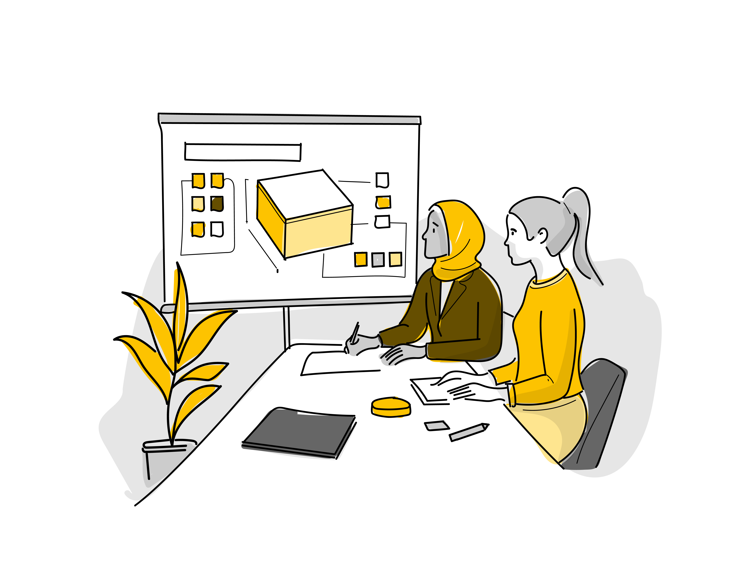
DEFINE
PHASE
121

Slide 32
DEFINE PHASE
DEFINE OBJECTIVES
The goal of the synthesis phase is to identify the unique needs, aspirations, and pain points of your stakeholders based on the research you conducted.
You will synthesize the information gathered from interviews and observations to uncover key insights. These insights should highlight meaningful patterns and reflect opportunities for innovation that address the real challenges faced by your stakeholders.
You will use these insights to reframe the original problem statement to an area of opportunity that emerged from your research.
This reframe will serve as the foundation for generating potential solutions that better meet the needs of your stakeholders.
DEFINE MINDSETS
Seek new perspectives on old problems
Look carefully to understand potential problems and opportunities
Stay optimistic that you can solve the problem
See opportunities in constraints
Get comfortable with navigating contradictory information
Hold back on solving the problem during this phase
1. Research Reflection
& Synthesis
2. Thematic
Clustering
3. Generate
Insights from Themes
4. Define
How Might
We Question
5. Align HMW with LO and LE

Slide 33
10 min
RESEARCH REFLECTION & SYNTHESIS
Reflect individually on your notes to identify key quotes, surprises, and contradictions from your interviews with students, parents, and teachers. Use this template to documents your Reflection of all the interviews.
A. Key Quotes
Highlight statements that stood out to you—those that are memorable, meaningful, or revealing of important perspectives.
B. Surprises
Reflect on what you hadn’t anticipated—whether it
was a new insight, behavior, or comment that shifted
your understanding.
C. Contradictions
Look for contradictions in what people said or how they behaved.
Identify conflicting viewpoints between different stakeholders (e.g., students vs. teachers) or within an individual’s own responses.
  STUDENTS
QUOTES:
SURPRISES:
CONTRADICTIONS:

Slide 34
10 min
RESEARCH REFLECTION & SYNTHESIS
Reflect individually on your notes to identify key quotes, surprises, and contradictions from your interviews with students, parents, and teachers. Use this template to documents your Reflection of all the interviews.
A. Key Quotes
Highlight statements that stood out to you—those that are memorable, meaningful, or revealing of important perspectives.
B. Surprises
Reflect on what you hadn’t anticipated—whether it
was a new insight, behavior, or comment that shifted
your understanding.
C. Contradictions
Look for contradictions in what people said or how they behaved.
Identify conflicting viewpoints between different stakeholders (e.g., students vs. teachers) or within an individual’s own responses.
  SCHOOL STAFF
QUOTES:
SURPRISES:
CONTRADICTIONS:
121

Slide 35
10 min
RESEARCH REFLECTION & SYNTHESIS
Reflect individually on your notes to identify key quotes, surprises, and contradictions from your interviews with students, parents, and teachers. Use this template to documents your Reflection of all the interviews.
A. Key Quotes
Highlight statements that stood out to you—those that are memorable, meaningful, or revealing of important perspectives.
B. Surprises
Reflect on what you hadn’t anticipated—whether it
was a new insight, behavior, or comment that shifted
your understanding.
C. Contradictions
Look for contradictions in what people said or how they behaved.
Identify conflicting viewpoints between different stakeholders (e.g., students vs. teachers) or within an individual’s own responses.
  FAMILY
QUOTES:
SURPRISES:
CONTRADICTIONS:
121
121

Slide 36
CONGRATULATIONS
FOR COMPLETING
THE DEFINE PHASE
121

Slide 37

GENERATE
PHASE
121

Slide 38
GENERATE PHASE
GENERATE OBJECTIVES
Translate problems into solutions by brainstorming as many ideas as possible
The goal of this phase is to use the HMW questions to generate many solutions.
By generating lots of solutions, you will get to innovative solutions. The best way to get a good ideas is to get a lot of ideas
At the end of this phase, all team members should be clear on 1 - 3ideasthey are interested in making and testing
GENERATE MINDSETS
Many ideas lead to good ideas
Defer judgment and criticism of ideas
Idea generation is not the time for evaluating ideas
Brainstorming is a collaborative team activity
Allow yourself to think of wild ideas
See opportunities in constraints
This phase is the time to solve the problem
1. Brainstorming Ideas
2. Assess and Prioritize
3. Learn from Others
4. Idea Dashboard

Slide 39
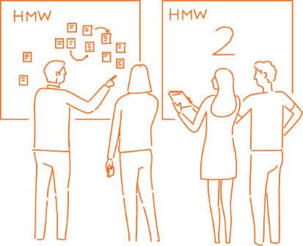

10 min
BRAINSTORMING
IDEAS - Individual
Document your clustered ideas:
Write the label/title give to each cluster and give a brief description. Each design team should come-up with at least 5 ideas
121

Slide 40
15 min
LEARN FROM OTHERS
When you research & learn, be sure to take notes on what you see and notice about the innovations. In this instance, less is more, it better to know more about 2-3 solutions than very little about 20 solutions.
Take the next 10 – 15 min to research, identify & learn from other teachers & designers who have innovated solution or ideas that align with yours.
Get Inspired from other successful or inspiring ideas
Focus on specific aspects of these innovations:
What learning outcomes does this innovation seem to address?
What learning environment practices does the innovation seem to target?
What makes these solutions successful?
What methods or techniques are being used that can be applied to your brainstormed ideas?
How do the solutions address challenges similar to those you’re tackling?
Innovation #1
Innovation #2
Innovation #3
Reflect:
Reflect:
Reflect:

Slide 41





IDEA DASHBOARD
The Idea Dashboard is a worksheet to simply articulate what your (early stage) idea or solution is.
Capturing a few details on this sheet can help you think through some of the basic details of your idea.
WHAT
Explain your core idea, solution, or intervention.
Be as specific and concise as possible.
Idea Name/Title :
WHO
Identify the primary beneficiaries of the solution. List out key characteristics of the beneficiary group.
Draw or visualise the idea
WHY
Why do you believe this solution will improve outcomes for stakeholders. What is the value or benefit they expect?
HOW
How do you envision the idea being implemented. Who will be responsible for making this idea happen, and what are the key steps involved?
121
Notes:
Reminder: Facilitators to share this tool specific to the academic cohort. Only Primary and Secondary teachers need to use the VITAL Building Blocks tool

Slide 42
CONGRATULATIONS
FOR COMPLETING
THE GENERATE PHASE
121

Slide 43

MAKE
PHASE

Slide 44
MAKE PHASE
MAKE OBJECTIVES
Build tangible or physical manifestations of your solutions.
These manifestations are intended to help bring your idea to life, allow others to interact with it and provide feedback, answer specific questions about the concept, and test assumptions or hypotheses about the idea.
At the end of this phase, all team members should have a clear plan for conducting an experiment to learn more about the idea.
MAKE MINDSETS
Stay optimistic that you can solve the problem
Experiment early and often in order to learn about your idea
Start small to make big change
Show don't tell
Many cycles of experimentation are necessary to develop an idea
1. Storyboard
Your Idea
2. Brainstorm Assumptions
3. Assess and Prioritize
4. Choose Experiment Format
5. Choose Experiment Strategy
6. MAKE Summary
121

Slide 45
20 min
MAKE PHASE SUMMARY
Document your MAKE Phase prioritization journey. This will ensure even after the workshop, each design team member has access to the decisions you made.
Which idea did you select/storyboarded for?
What were the key assumptions your prioritized?
1.
2.
3.
Which experiment format did you select?
1.
2.
What was the Chosen Experiment Strategy
1.
2.
3.
121

Slide 46
CONGRATULATIONS
FOR COMPLETING
THE MAKE PHASE

Slide 47

TEST
PHASE
121

Slide 48
TEST PHASE
TEST OBJECTIVES
Test your solution in your classroom and school community to gather feedback, answer specific questions about the concept, and test the assumptions or guesses you have made about your ideas.
While we will practice only one test during the session, you should aim to run multiple tests with learners and teachers in your classroom before you are ready to implement.
TEST MINDSETS
Experiment early and often to learn about your idea.
Start small to create big change.
Show, don’t tell.
Many cycles of experimentation are necessary to develop an idea.
Feedback is a gift to improve your ideas.
1. Practice a Test
2. Testing Plan
3. Reflection Grid
4. What did you learn?
5. Now what’s next?
121

Slide 49
20 min
TESTING PLAN
Assumption #1
Use the testing tool provided to outline your testing plan.
You don’t need to complete every section; skip any that don’t apply.
1. What Assumption Will You Be Testing With Your Prototype?
3. Who Might Help You Test The Prototype?
6. What Materials Will You Need?
(Specify what you will use the material for and the quantity)
7. Anything Else You Need To Prepare?
4. Where Will You Test The Prototype?
8. What Are The Steps That You Need To Complete In Order To Test Your Prototype?
1.
2.
3.
4.
5.
2. Generate A List Of People Who You Would Like To Have Participate In Your Prototype.
5. How Will You Set Up The Space?
121

Slide 50
20 min
TESTING PLAN
Assumption #2
Use the testing tool provided to outline your testing plan.
You don’t need to complete every section; skip any that don’t apply.
1. What Assumption Will You Be Testing With Your Prototype?
3. Who Might Help You Test The Prototype?
6. What Materials Will You Need?
(Specify what you will use the material for and the quantity)
7. Anything Else You Need To Prepare?
4. Where Will You Test The Prototype?
8. What Are The Steps That You Need To Complete In Order To Test Your Prototype?
1.
2.
3.
4.
5.
2. Generate A List Of People Who You Would Like To Have Participate In Your Prototype.
5. How Will You Set Up The Space?
121

Slide 51
20 min
TESTING PLAN
Assumption #3
Use the testing tool provided to outline your testing plan.
You don’t need to complete every section; skip any that don’t apply.
1. What Assumption Will You Be Testing With Your Prototype?
3. Who Might Help You Test The Prototype?
6. What Materials Will You Need?
(Specify what you will use the material for and the quantity)
7. Anything Else You Need To Prepare?
4. Where Will You Test The Prototype?
8. What Are The Steps That You Need To Complete In Order To Test Your Prototype?
1.
2.
3.
4.
5.
2. Generate A List Of People Who You Would Like To Have Participate In Your Prototype.
5. How Will You Set Up The Space?
121

Slide 52
30 min
REFLECTION GRID
Assumption #1
Use the following tool to reflect on the feedback shared by stakeholders or any observations you made. Focus on these sections: what you liked, what changes need to be made, what questions were raised, and what ideas you observed.
Likes
What did you see or hear that is working well?
Changes
What did you see or hear that needs to be changed?
Questions
What did you see or hear that raised questions for you?
Ideas
What ideas came to mind as you observed or listened?
121

Slide 53
30 min
REFLECTION GRID
Assumption #2
Use the following tool to reflect on the feedback shared by stakeholders or any observations you made. Focus on these sections: what you liked, what changes need to be made, what questions were raised, and what ideas you observed.
Likes
What did you see or hear that is working well?
Changes
What did you see or hear that needs to be changed?
Questions
What did you see or hear that raised questions for you?
Ideas
What ideas came to mind as you observed or listened?
121

Slide 54
30 min
REFLECTION GRID
Assumption #3
Use the following tool to reflect on the feedback shared by stakeholders or any observations you made. Focus on these sections: what you liked, what changes need to be made, what questions were raised, and what ideas you observed.
Likes
What did you see or hear that is working well?
Changes
What did you see or hear that needs to be changed?
Questions
What did you see or hear that raised questions for you?
Ideas
What ideas came to mind as you observed or listened?
121

Slide 55
CONGRATULATIONS
FOR COMPLETING
THE TEST PHASE
121

Slide 56
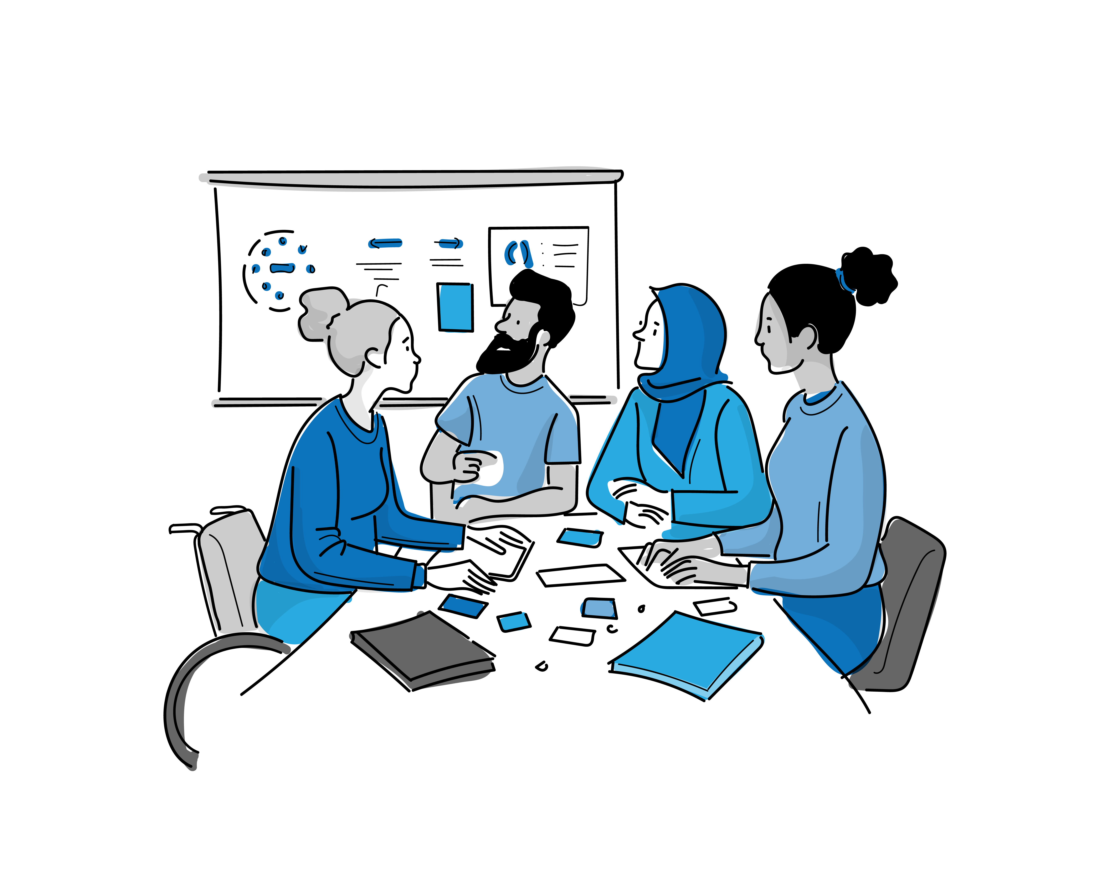
PLAN
PHASE
121

Slide 57
SCHOOLS 2030 HUMAN-CENTERED DESIGN WORKBOOK
PLAN PHASE
PLAN OBJECTIVES
You are moving from an idea you’re developing to a concept
you are preparing to implement.
The goal of this phase is to align your design team around the next steps required to implement your concept if you were to receive funding. Consider your long-term goals for improving students' holistic learning outcomes.
It is important to transition from focusing only on what is desirable to also considering what is feasible and viable.
PLAN MINDSETS
Shift from idealism to realism by considering the resources, partnerships, and skills required to make the concept practical and sustainable.
Break down the concept into actionable steps with clear roles and responsibilities, ensuring alignment within the team.
Stay open to adjustments based on feedback or new insights, allowing the plan to evolve to meet real needs.
Look at how the solution could grow or adapt to benefit more stakeholders, aiming for long-term impact
Identify key partners and resources needed, readying the team for effective communication and delegation.
1. Plan Your Intervention
121

Slide 58
60 min
PLAN YOUR INTERVENTION
Use the testing tool provided to outline your testing plan.
You don’t need to complete every section; skip any that don’t apply.
TEAM & CAPABILITIES
Take a look at your existing team.
How are you going to start the project?
What people or skills do you need to make your selection happen?
Who would be most essential members of the implementation team?
Who will be responsible for leading this project?
How should the team be organized?
Which critical skills will be required? Are there any specific skills that you are missing in your team?
Is there a need for consultancies or outsourcing to fill the skills gap?
Consider the gender balance of the team.
BUDGET
How much much will your intervention cost?
What do you need money for? Consider elements like travel, staff, equipment, developing materials and others.
Are you able to get revenue from the users themselves?
Where will the money come from?
STAKEHOLDERS & PARTNERS
Which stakeholders need to participate?
Are there organizations your team needs to partner with?
Are they development agencies, civil society organizations or private companies?
Why?
What added value will they bring?
How will you manage those partnerships?
What roles and responsibilities each party will have?
TIMELINE
Gather the key stakeholders in your project and collectively figure out a timeline.
What needs to happen in the next month? In three months? In a year?
Think about the major milestones in your project timeline:
When will you launch? When will you need to complete your technical development by? When will you kick off a communications plan? Discuss key dates with your team.
121

Slide 59
60 min
PLAN YOUR INTERVENTION
Use the testing tool provided to outline your testing plan.
You don’t need to complete every section; skip any that don’t apply.
RISK MITIGATION
What could limit the success of your concept?
For each risk you identified, what strategies could you use to investigate those risks?
How will you ensure your initiative does not reinforce existing inequalities between men and women (boys and girls), and/or create new ones?
MONITORING & EVALUATION
How will you know if your concept is working?
How do you plan to measure and evaluate your results?
Who will help you in this effort?
What qualitative and quantitative indicators do you want to track and monitor?
What decisions can be made with those indicators?
PROJECT MILESTONES
Gather the key stakeholders for your project and collectively map out a timeline for implementation. Think about the major milestones in your project timeline:
When will you launch the project implementation?
What approvals do you need to secure before the launch of project implementation?
By when will you need to complete the development of any resources?
When will you kick off a communications plan?
COMMUNICATION
For this project to be successfully implemented, what do you need to communicate? And to whom?
Do you need to get approvals from those supervising the project? From external partners?
Given the key stakeholders you identified, what is your plan for communicating to each group?
What needs to be communicated
in the next month?
In three months? In a year?
Discuss key dates with your team.
121

Slide 60
CONGRATULATIONS
FOR COMPLETING
THE PLAN PHASE
121

Slide 61
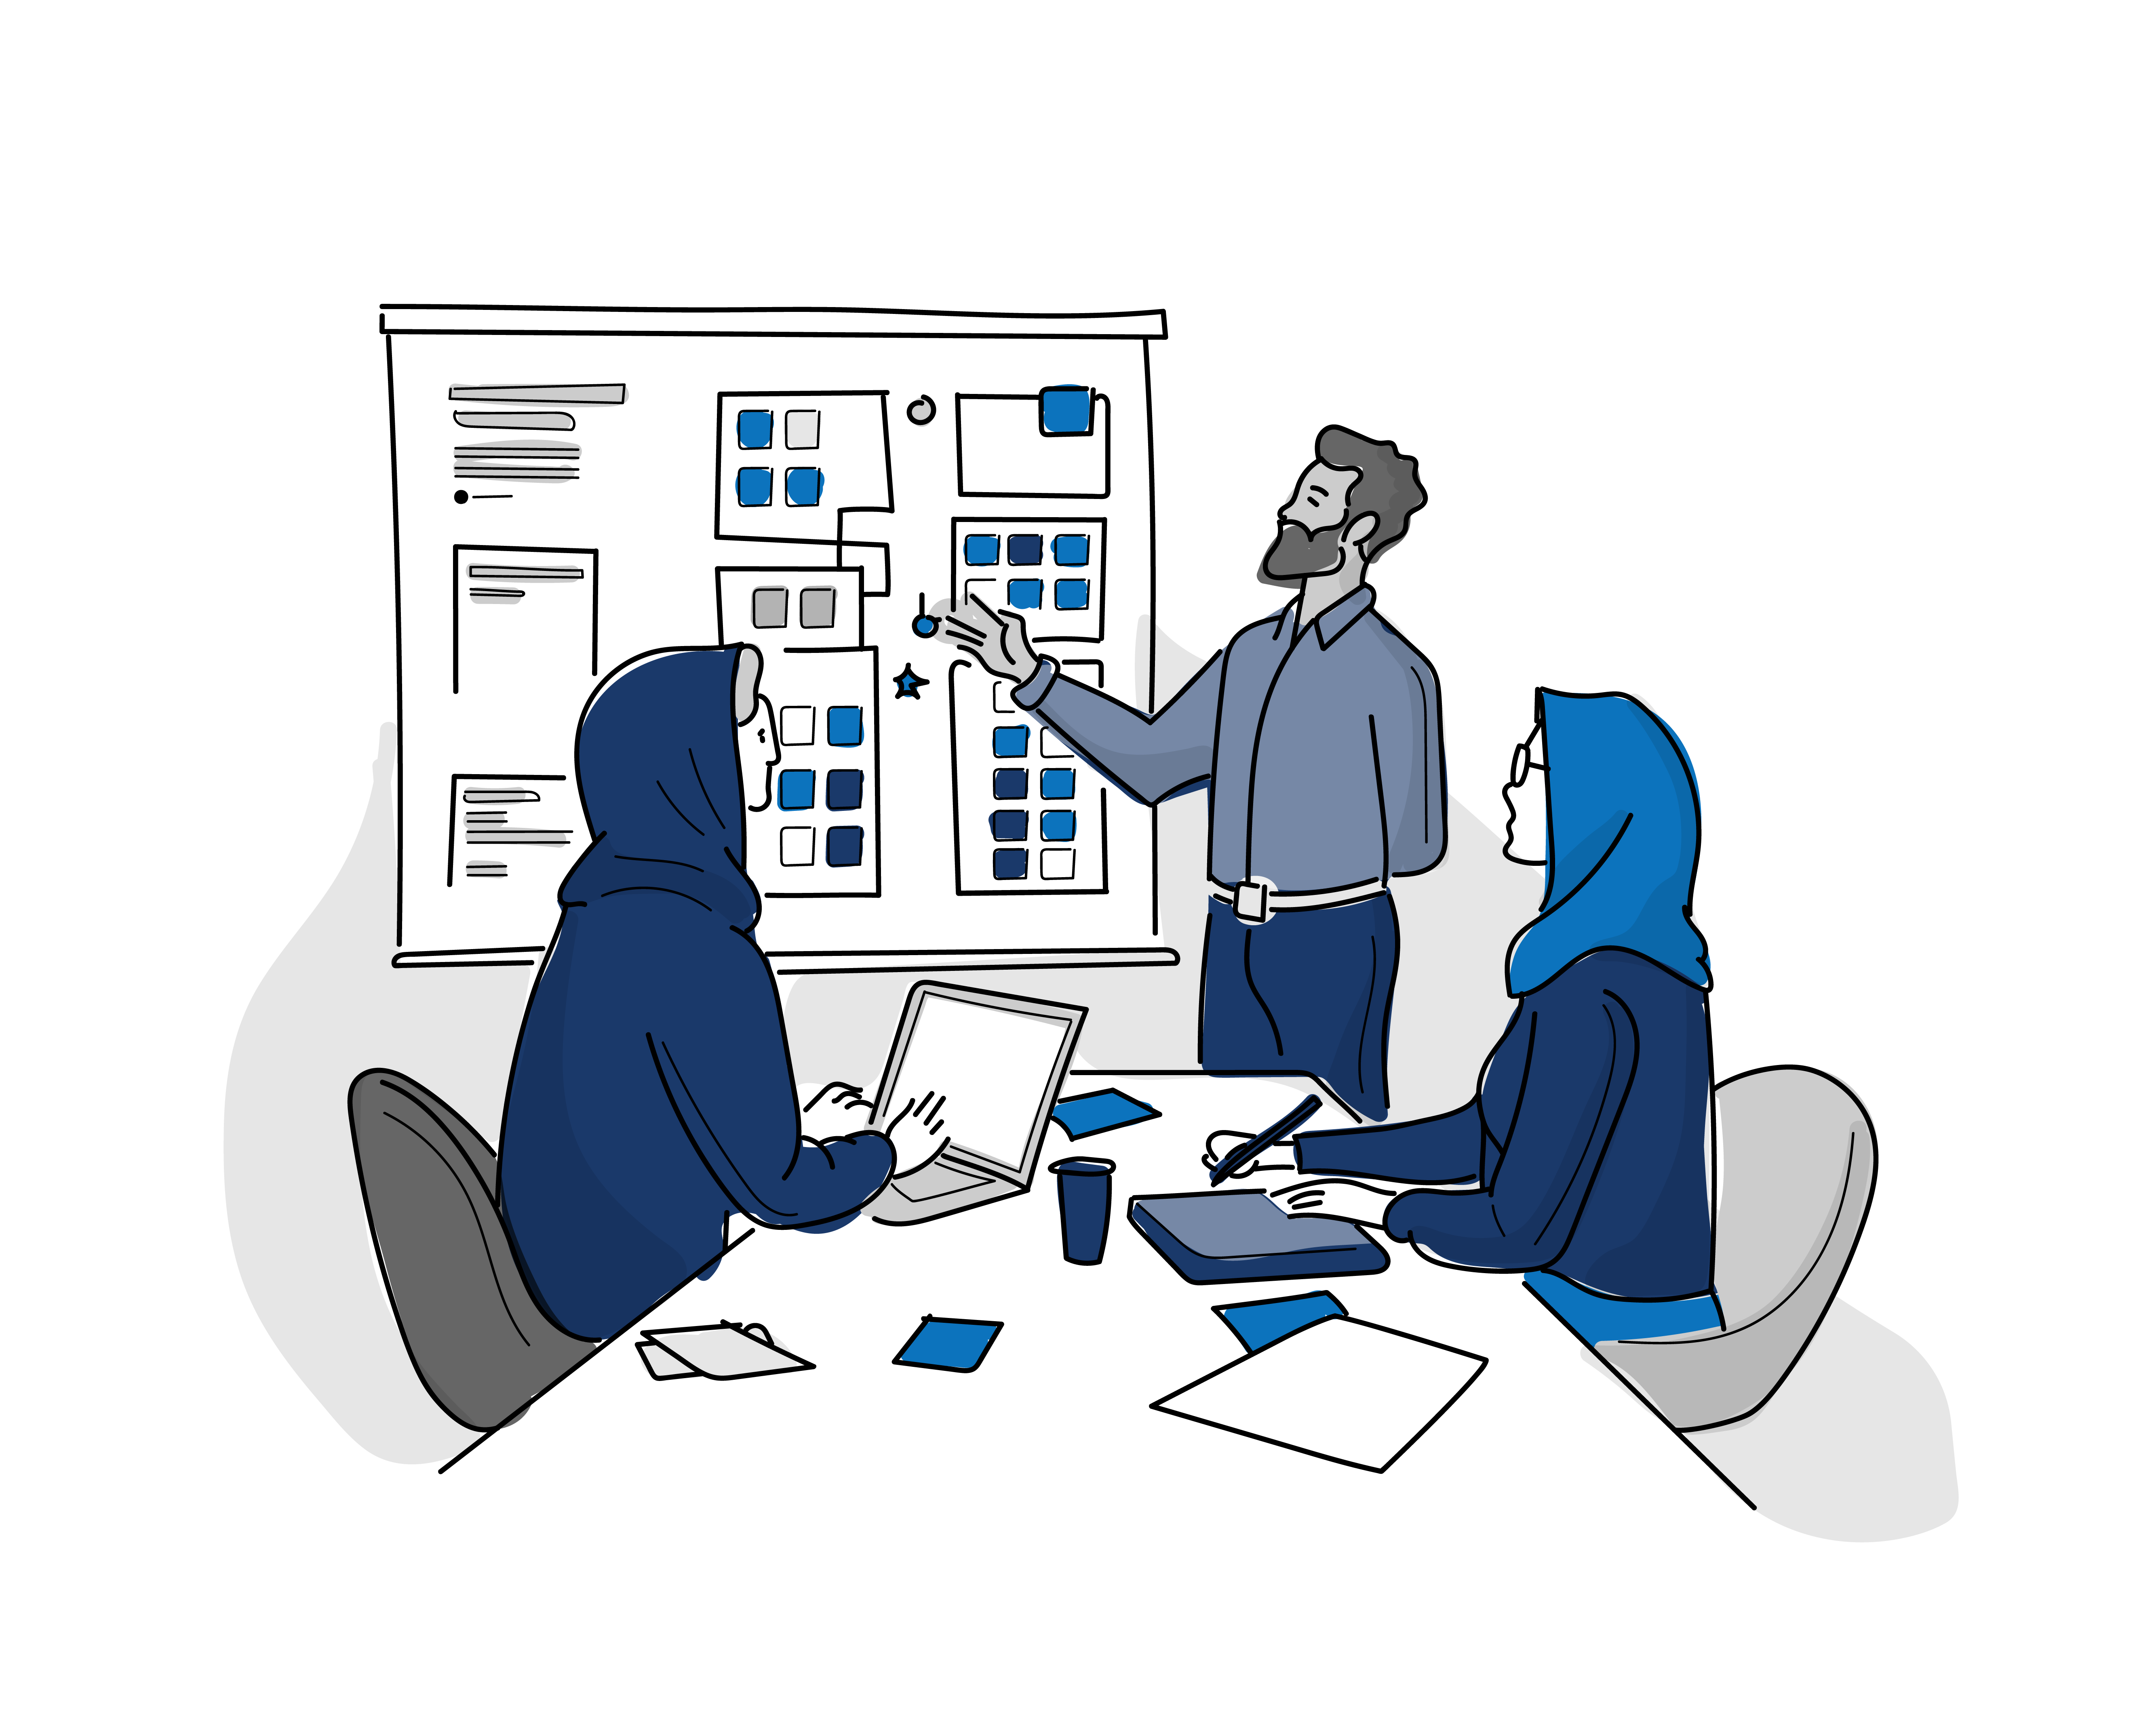
TELL
PHASE
121

Slide 62
TELL PHASE
TELL OBJECTIVES
Communicate what you learned about your solution and
why it has the potential to meet the stakeholder’s needs
Synthesize what you learned from your design work and testing to share your insights and ideas in a human-centered way.
TELL MINDSETS
Get inspired by people
Many cycles of testing are necessary to develop an idea
Feedback is a gift to improve your ideas and communication
1. Develop
Your Story
3. TELL
Summary
121

Slide 63
20
MIN
60 min
TELL PHASE SUMMARY
Tell us more about your primary stakeholder.
What was the surprising observation you made? What did you discover?
What concept did you create? What assumptions were you testing in your prototypes?
How have your prototypes evolved? What have you learned about your concept?
What concept are you going to implement? What outcomes are you hoping for in terms of improving the outcomes for stakeholder?
121

Slide 64
CONGRATULATIONS
FOR COMPLETING
THE TELL PHASE
121

Slide 65

www.schools2030.org
SCHOOLS 2030 HUMAN-CENTERED DESIGN SPRINT

